Slide 1
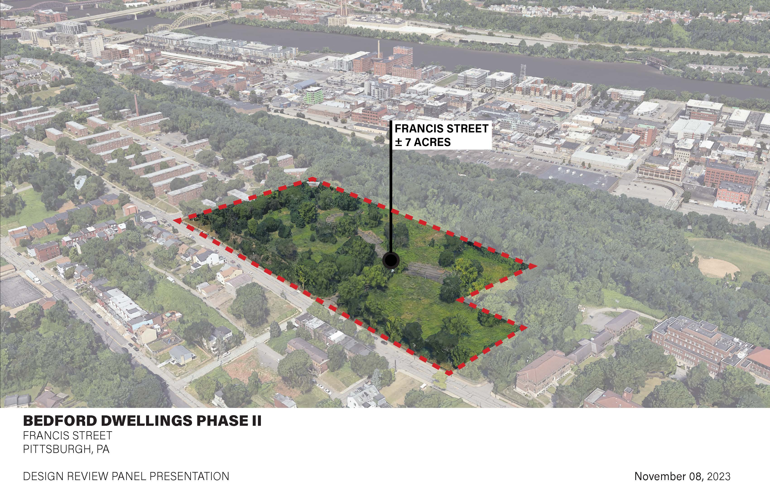
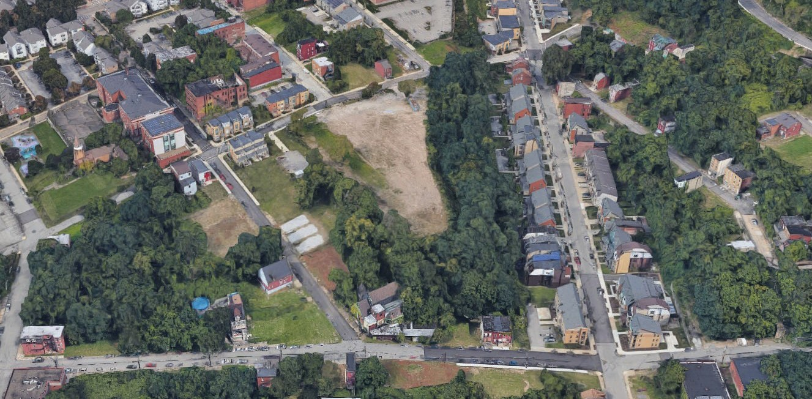
BEDFORD DWELLINGS REDEVELOPMENT PHASE II
FRANCIS STREET REDEVELOPMENT
PITTSBURGH, PA
DESIGN REVIEW PANEL PRESENTATION
NOVEMBER 8, 2022

Slide 2
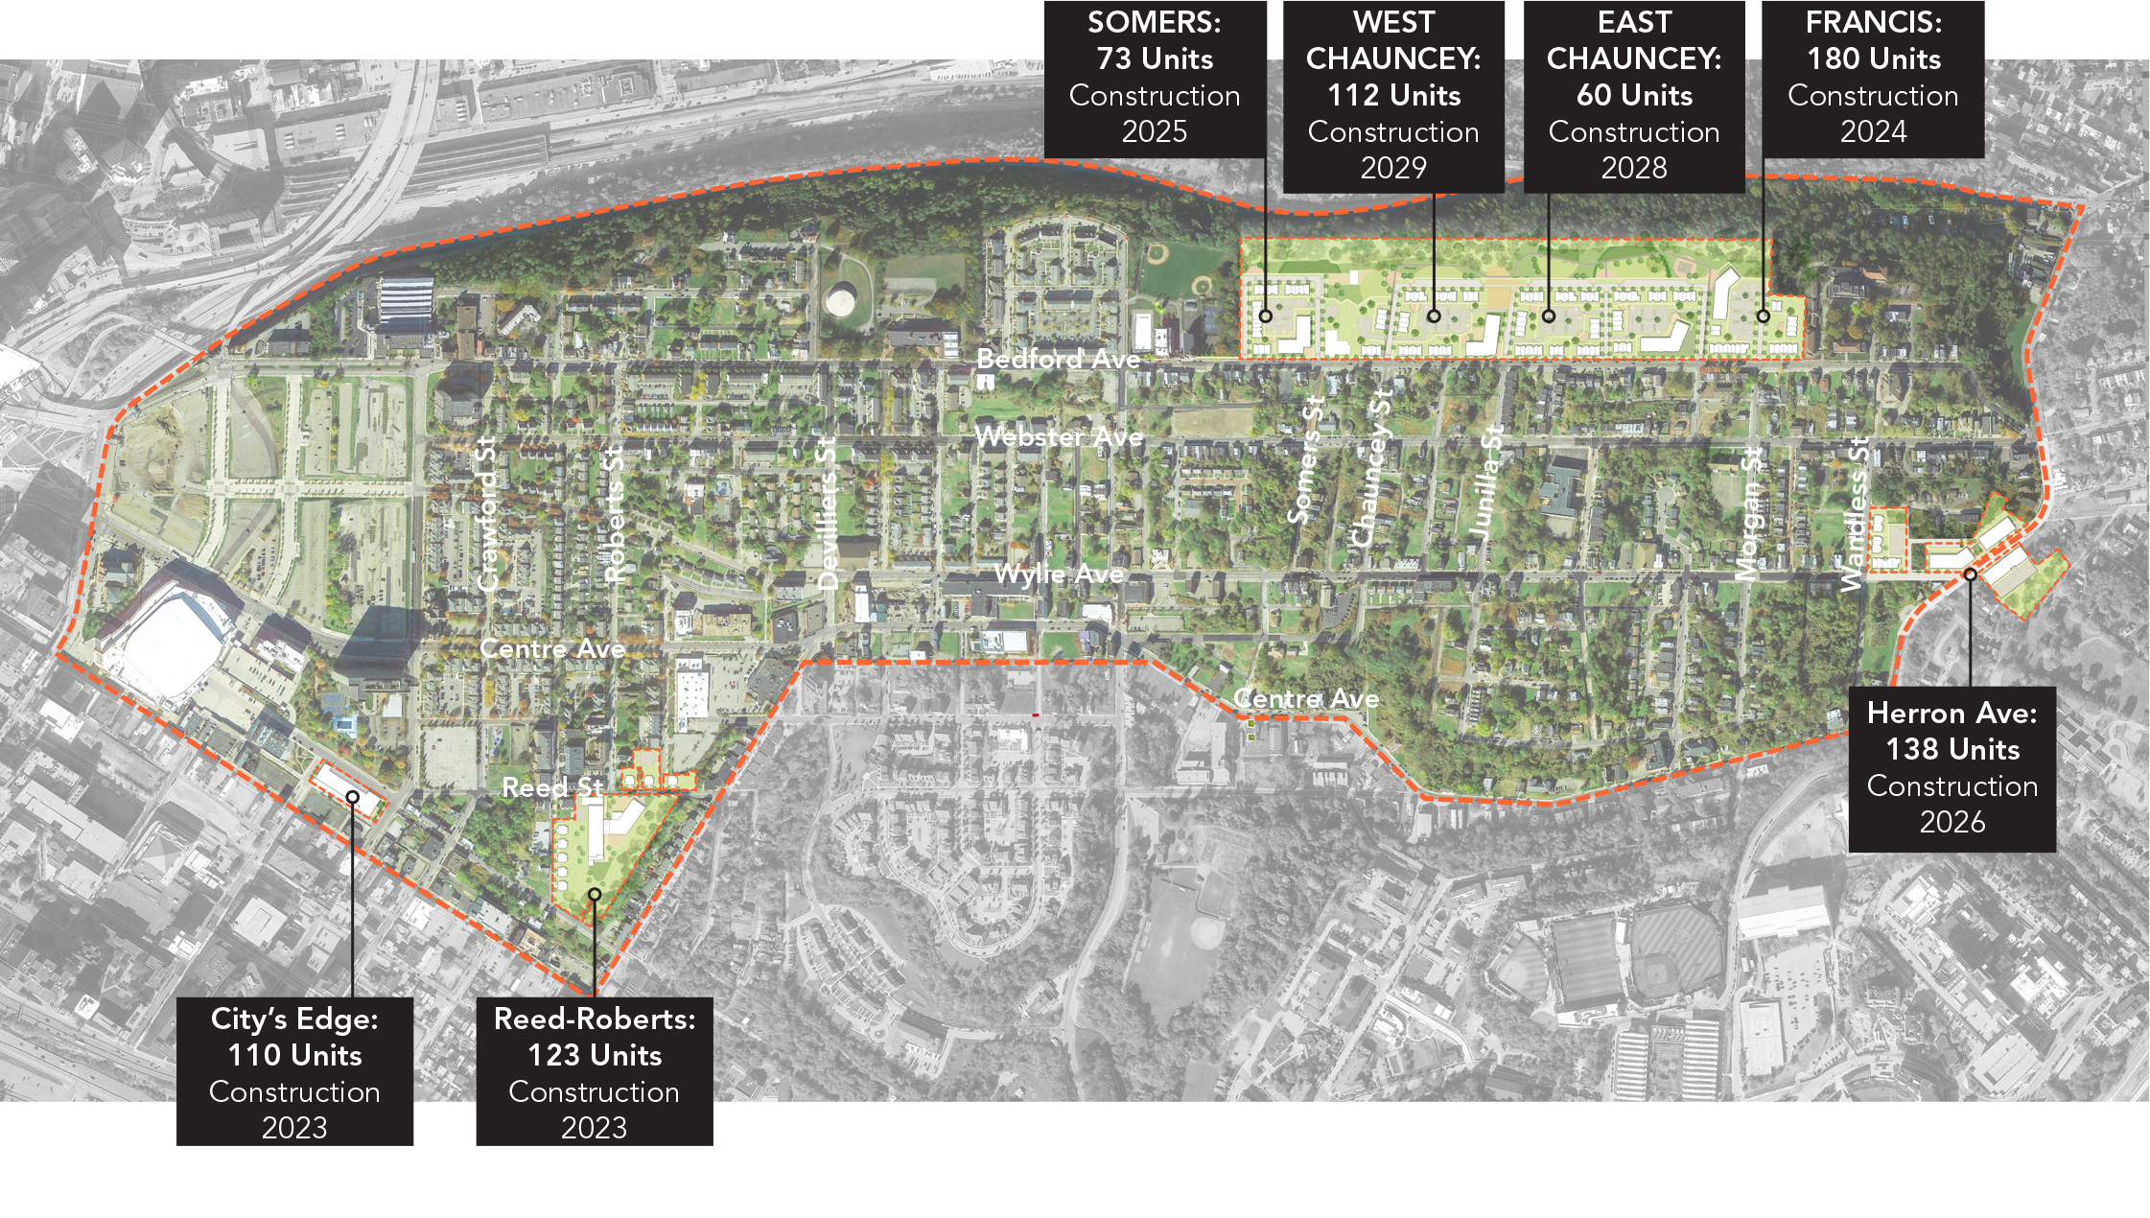

Bedford Dwellings/Hill District CNI
Lead Grantee: Housing Authority City of Pittsburgh
Co-Grantee: City of Pittsburgh
Implementation Entities:
  Housing: Trek Development Group, Allies & Ross Management and Development (ARMDC), and MidPoint Group of Companies
  Neighborhood: Urban Redevelopment Authority
  People: Allegheny County Department of Human Services

Slide 3
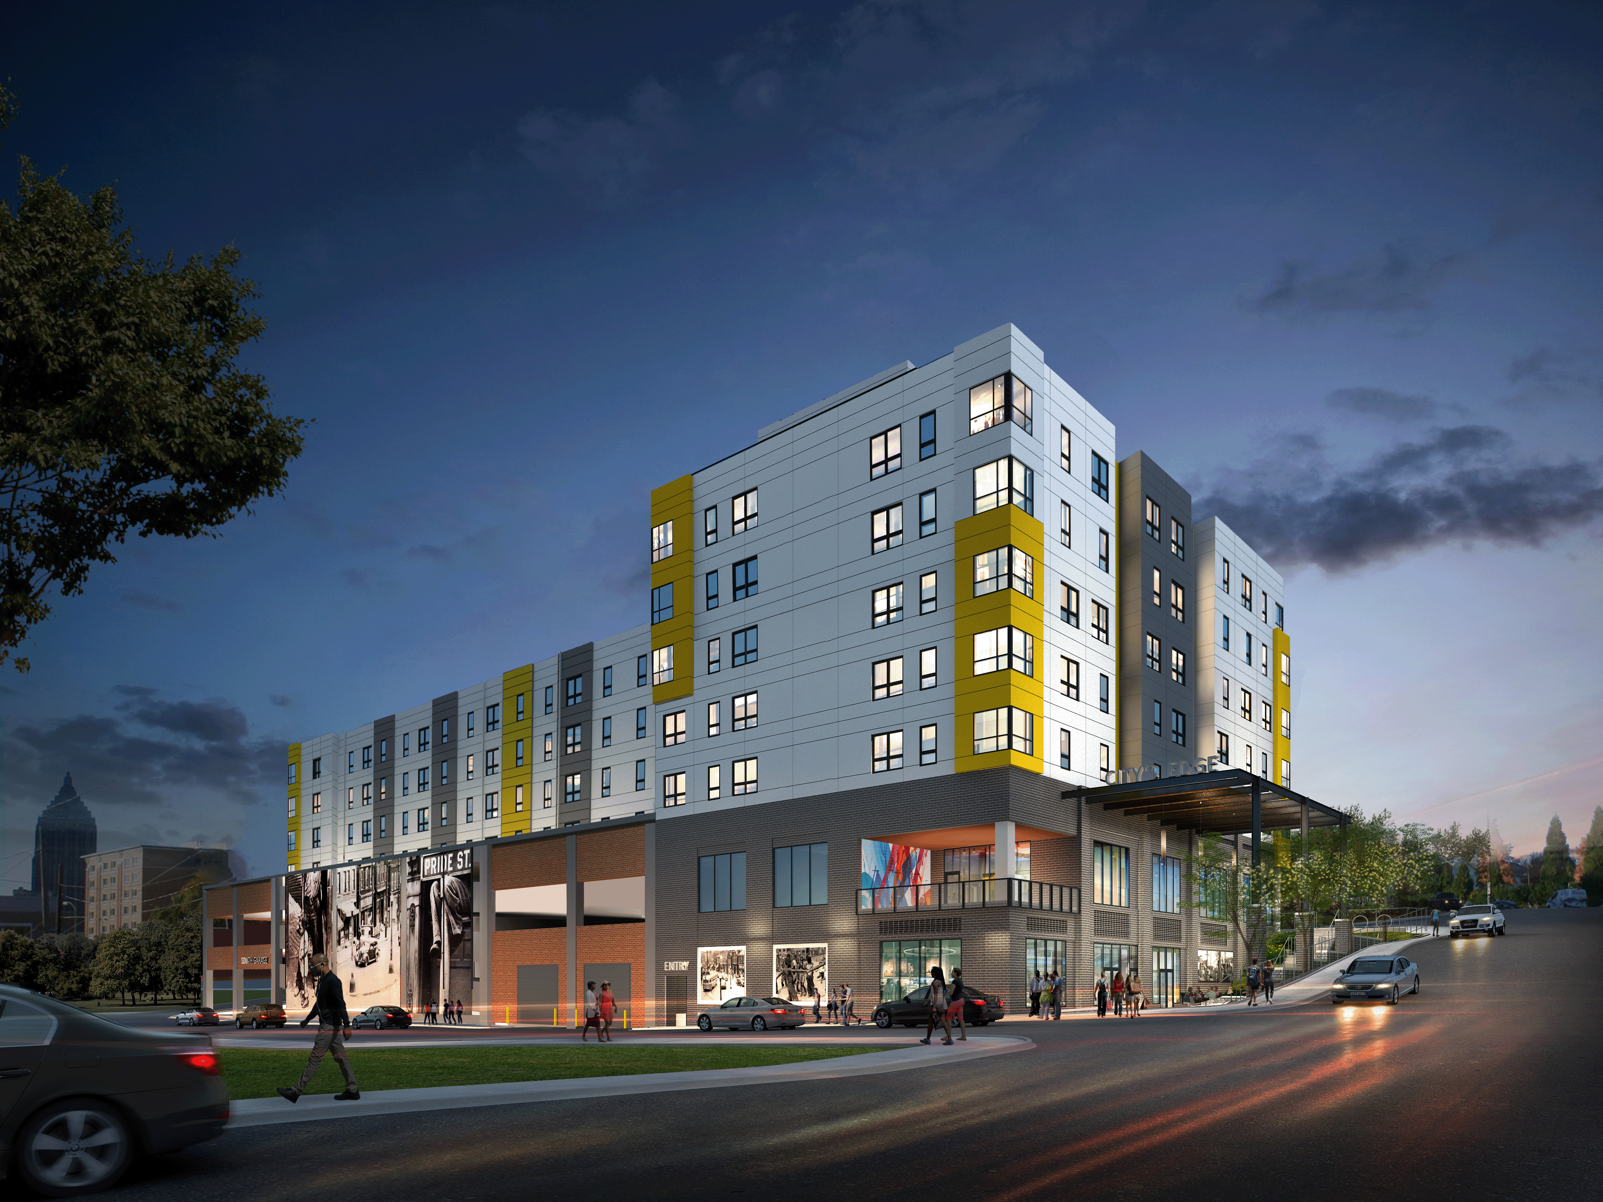
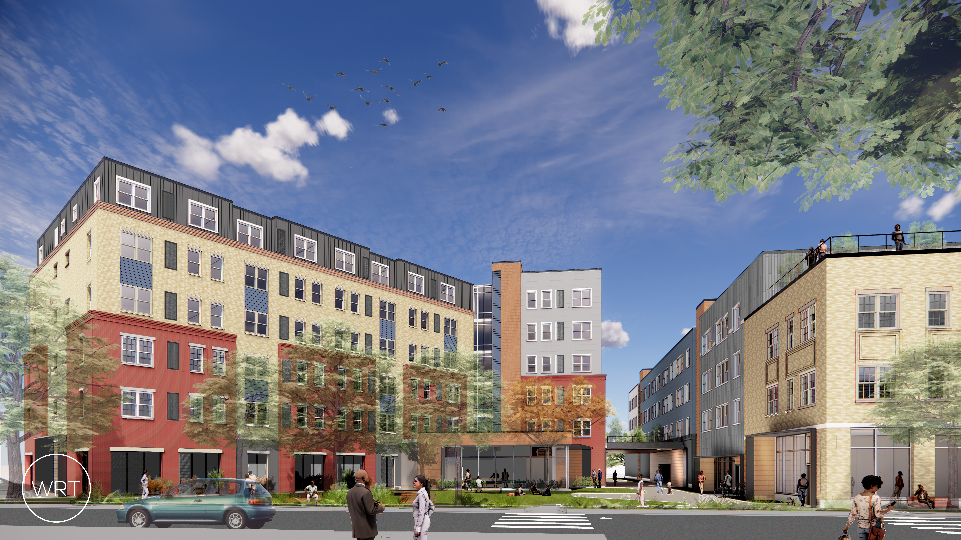
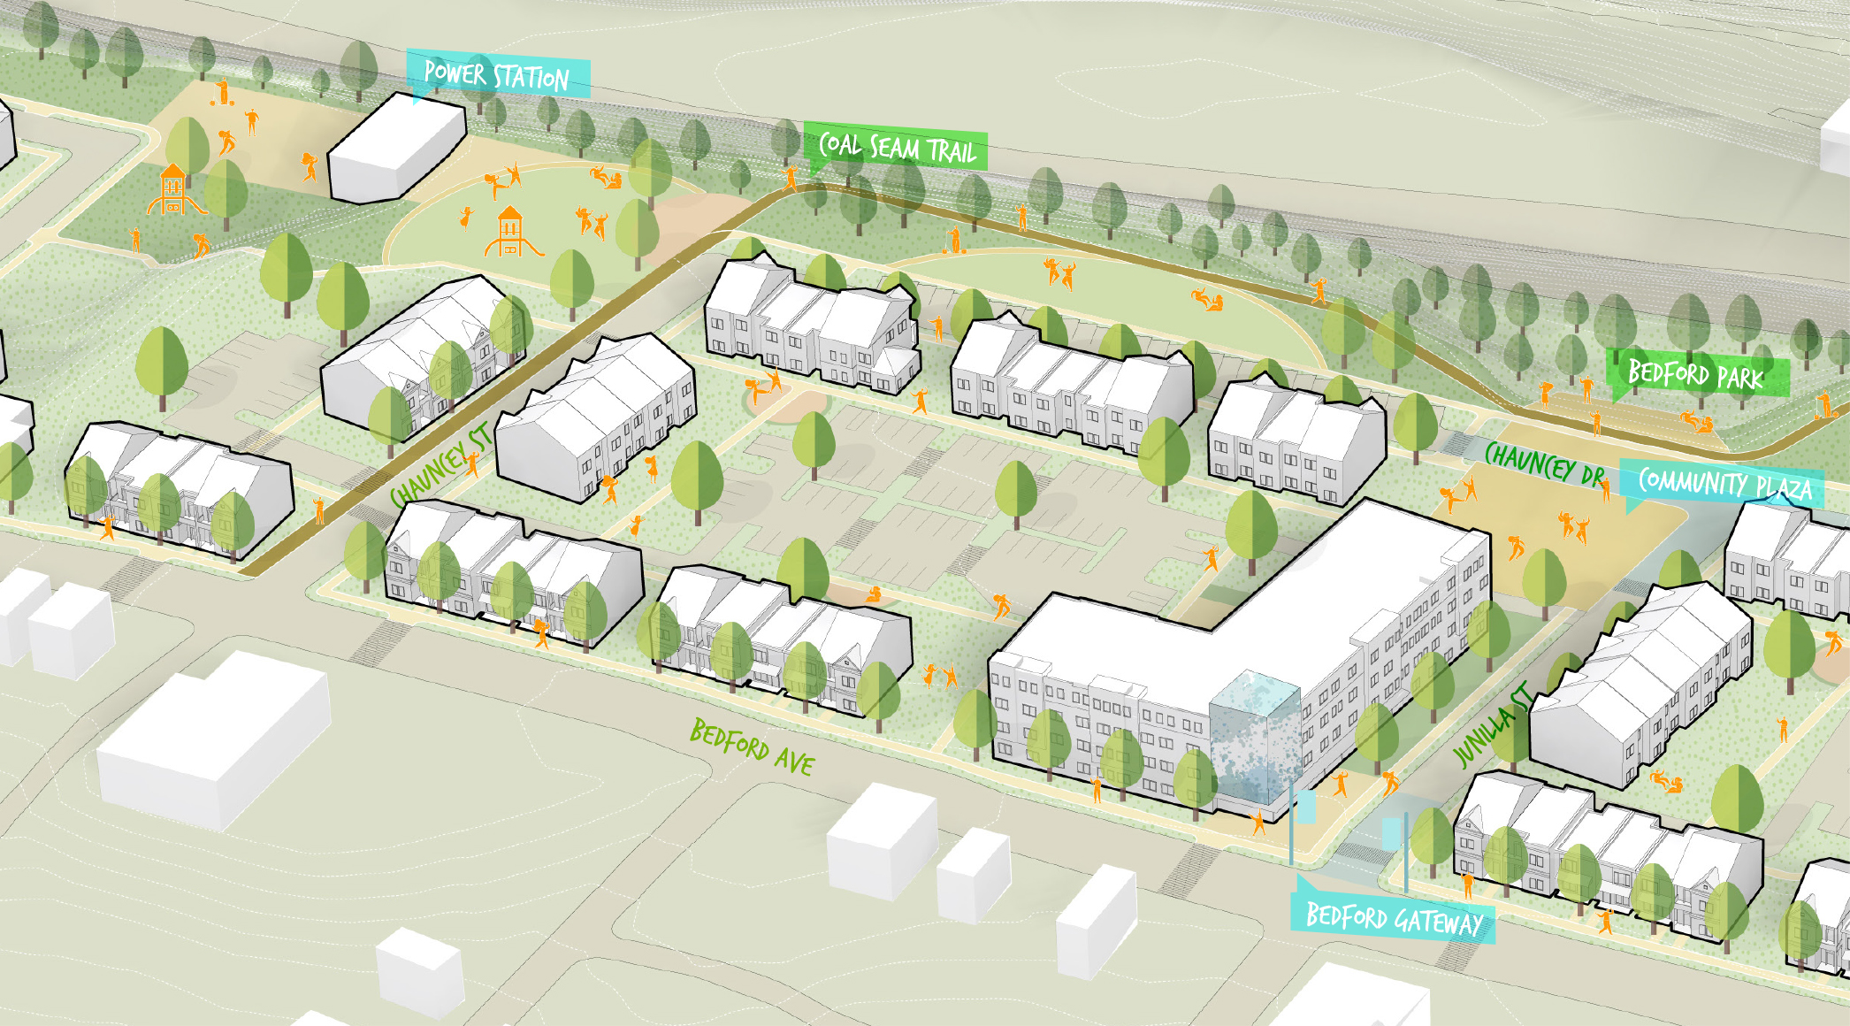
Bedford Dwellings/ Hill District CNI Grant Plan
People:
Robust and trauma-informed case management and supportive services
Behavior health support team
Neighborhood:
New Public Trail (Coal Seam Trail)
Creation of New Homeownership Opportunities
Supported mixed-use and commercial corridors
Façade repair for homeowners
Housing:
823 new units of high-quality Mixed-Income Housing
411 Replacement Units

Slide 4





















Choice People Program Structure
Case Managers
Residents
People Project Manager
Behavioral Health
Support Team
Health and Services Support Network
UPMC
Health Liaison
Highmark
Life Pittsburgh
Community Care Behavioral Health
Workforce Liaison
Community
Partners
Career Link
Education Liaison
Ebeneezer Outreach/CVS
ABK child care
PPS
First Source Center
Afterschool partners
Hill District Family Center
Alliance for Infants and Toddlers
Notes:
Additional talking points:
caseload ratios: up to 50
Case management approach: trauma-informed, coaching style
No formal assessments completed; engaged and assisted12 families so far through meetings and events
Data management and data sharing: DHS data warehouse, client path molded for HUD metrics

Slide 5
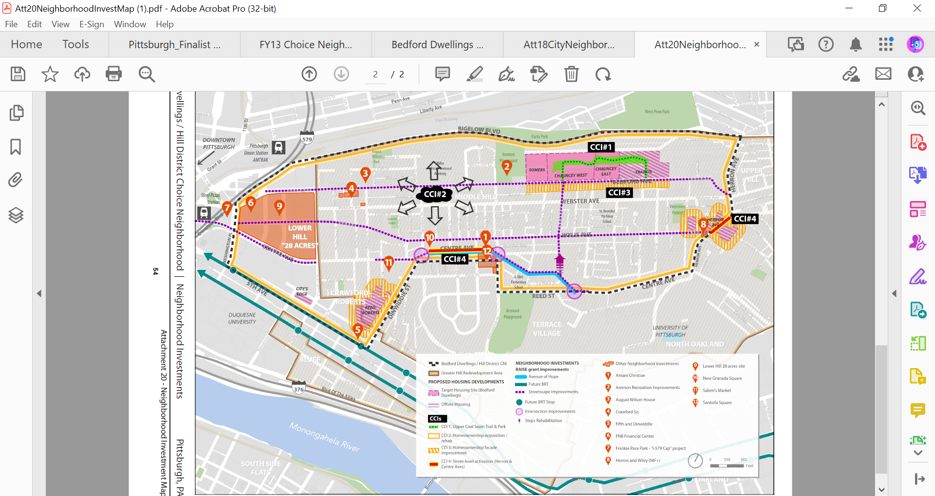
Notes:
Talking Points:
Reiterate site tour as best as possible.
Call attention to CCIs.
CCI#1 and CCI#3 were both rated as highly desired by the community in our outreach.
CCI#2 Is renovation for existing homeowners and taking place throughout the neighborhood.
CCI#4 is the URA's specialty—economic development. Already doing this on Centre.

Slide 6
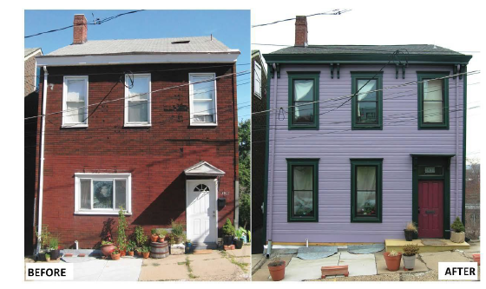
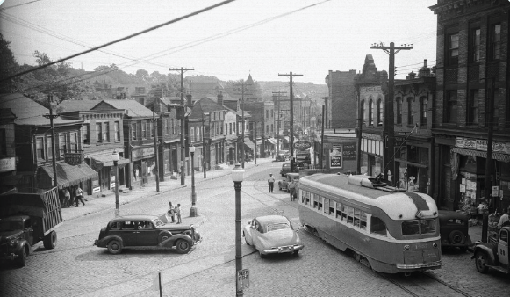
Critical Community Improvements
Existing Homeowners Façade Improvements
Commercial / Street-front Activation along Herron and Centre Avenues

Slide 7
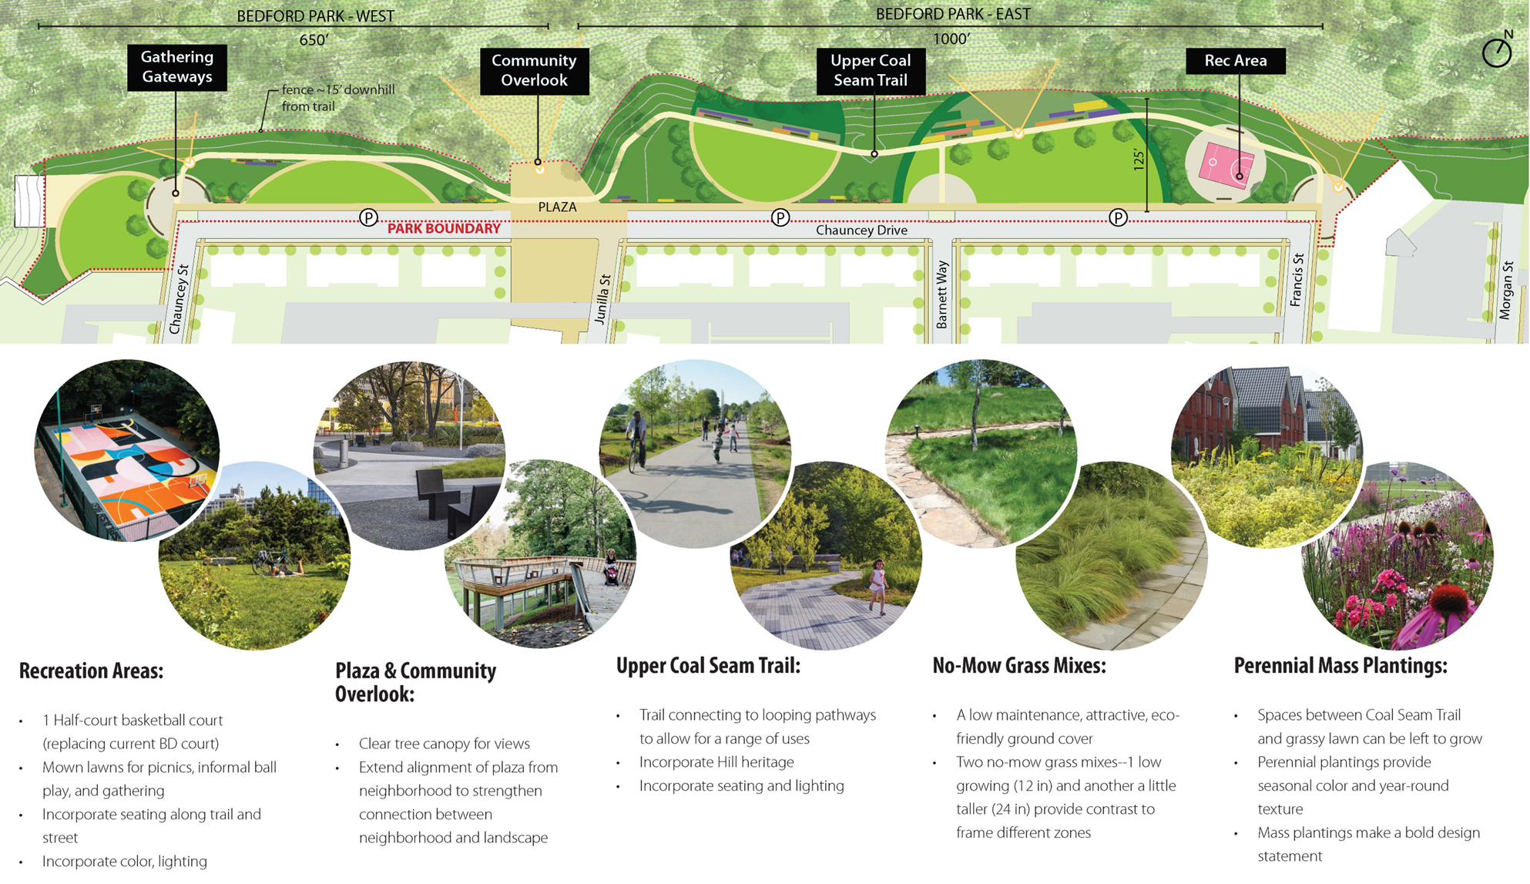
Creation of New Homeownership Opportunities
4. Trail Behind Current Bedford Dwellings “Coal Seam Trail”

Slide 8


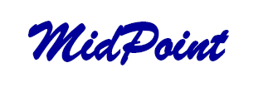
Housing Sites:

Slide 9
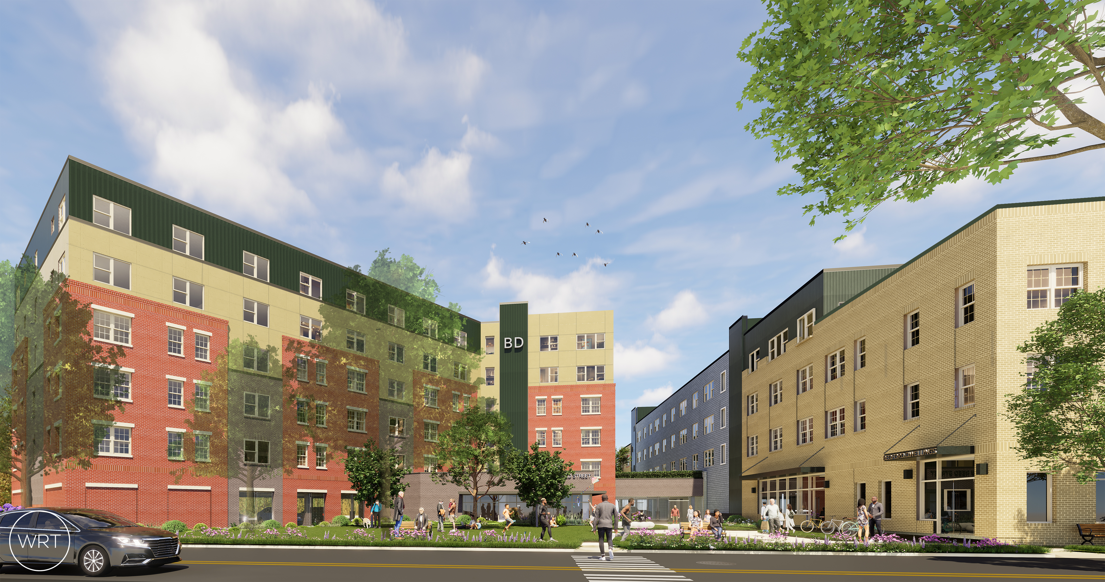
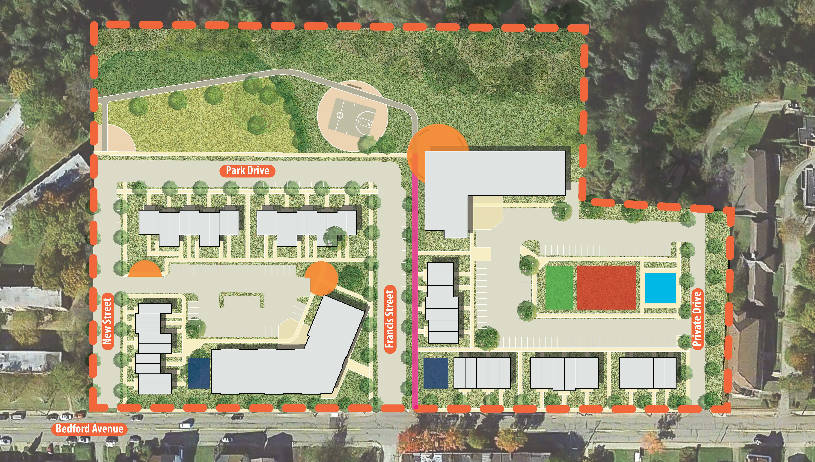
By Bedroom Type:
Unit Types: | Market | LIHTC | Replacement | TOTAL
1 Bedroom | 107 | 103 | 209 | 419
2 Bedroom | 58 | 98 | 139 | 295
3 Bedroom | 35 | 8 | 36 | 79
4 Bedroom | 2 | 1 | - | 3
Total | 202 | 210 | 384 | 796
% of Units: | 25% | 26% | 50% | 100%
+ 27 additional off-site PBV by Others

Slide 10
Choice Grant Schedule

Slide 11
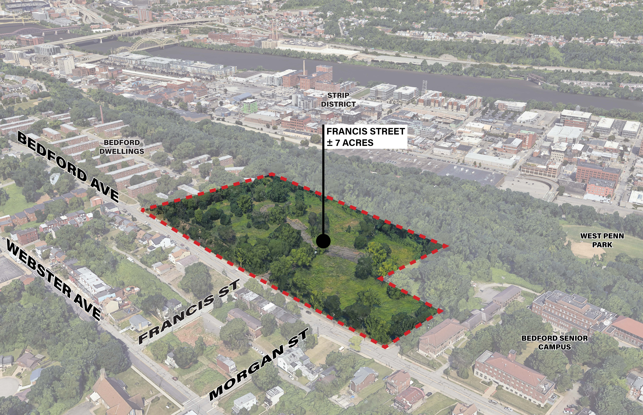
BEDFORD DWELLINGS PHASE II DEVELOPMENT
Phase 3 of Bedford Dwellings Redevelopment and US Department of Housing and Urban Development’s Choice Neighborhoods Implementation Grant Application
1 for 1 replacement of the lower portion of Bedford Dwellings units (103 Replacement units)
  Additional market rate and affordable units to be constructed
This development will utilize a twinning strategy, using both 9% and 2 4% LIHTCs from PHFA
Accessibility Goals:
  10% of all units to be accessible- UFAS
  All units Visitable
Sustainability Goals
  Zero Energy Ready Homes
  Enterprise Green Communities
  Energy Star
Notes:
Project introduction/ Why we are here

Slide 12
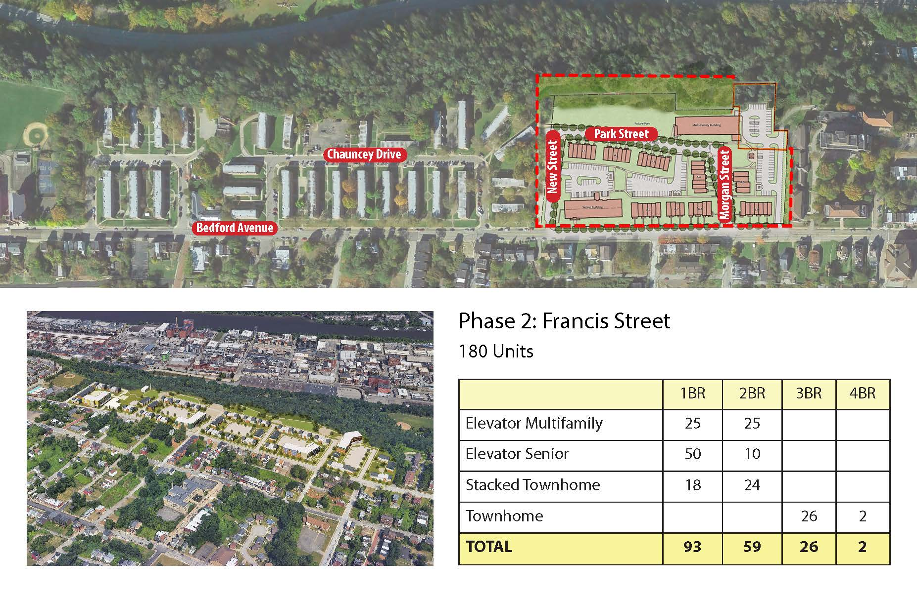
Notes:
Discussion: Quick intro of immediate site surroundings and topography

Slide 13


Slide 14
DEVELOPMENT TEAM
  HOUSING AUTHORITY OF THE CITY OF PITTSBURGH (HACP)
    Land Owner (Site Acquisition Entity)
  ALLIES AND ROSS MANAGMEMENT AND DEVELOPMENT CORPORATION
    Development Instrumentality of HACP
    Co-Developer
  TREK DEVELOPMENT GROUP
    Co-Developer/ Property Manager
  FULANI DEVELOPMENT
    Minority Business Enterprise
    Development Mentee
Notes:
Quick introduction of Development team members

Slide 15
DESIGN TEAM
  WRT
    Architect
  BOHLER ENGINEER
    Lead Civil Engineer
  LAQUANTRA BONCI
    Landscape Architect
  SCI-TEK ENGINEERS
    Minority Business Enterprise
    Civil Engineering and Environmental Engineer
  SHEFFLER & COMPANY
    Women Business Enterprise
    Survey
  GEOMECHANICS, INC
    Minority Business Enterprise
    Geothecnical Engineer
Notes:
Introduction of Design team members: Highlight MWBE participation

Slide 16
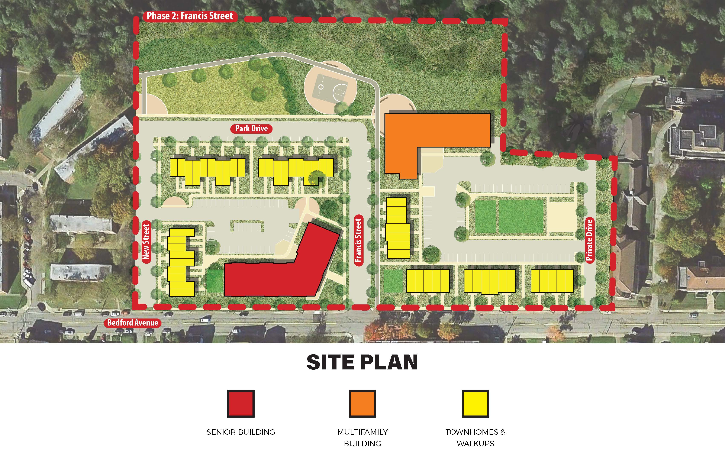
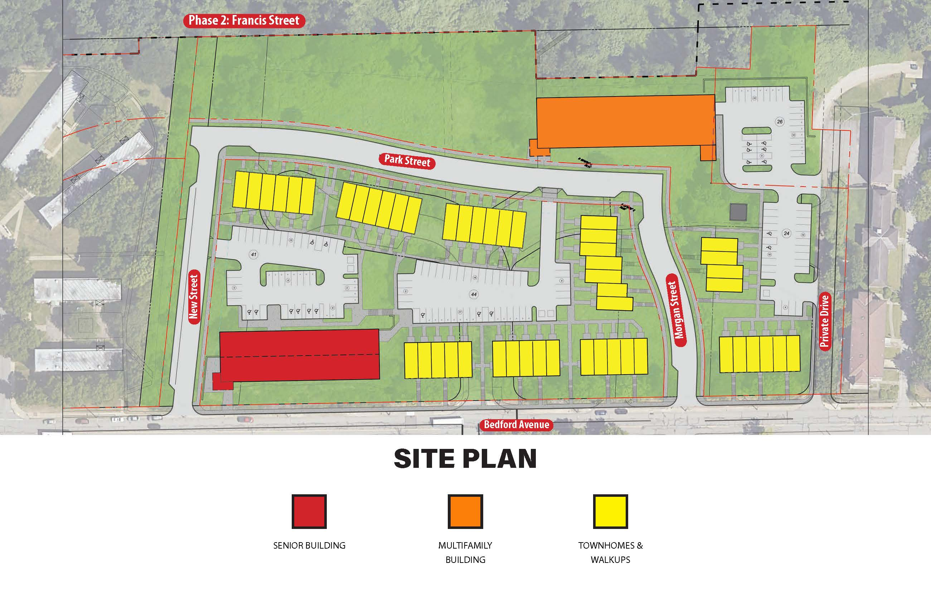
Previous Site Plans
Choice Application Site Plan
Pro: Maintained Francis Street Connection
Con: Site too sloped to make buildings and Park accessible
Choice Application Site Plan
Pro: Maintained Morgan Street Connection and Hill Neighborhood
Ability to make site fully accessible
Con: Does respond to Neighborhood connotations (height of surrounding buildings, location of bus stops)

Slide 17
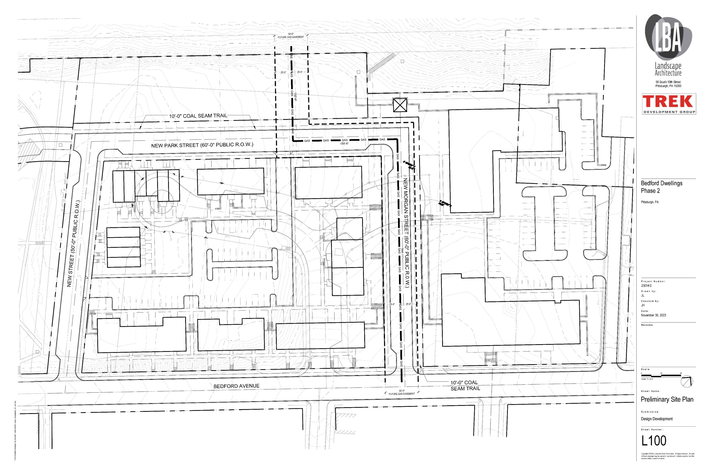
Current Site Plan

Slide 18
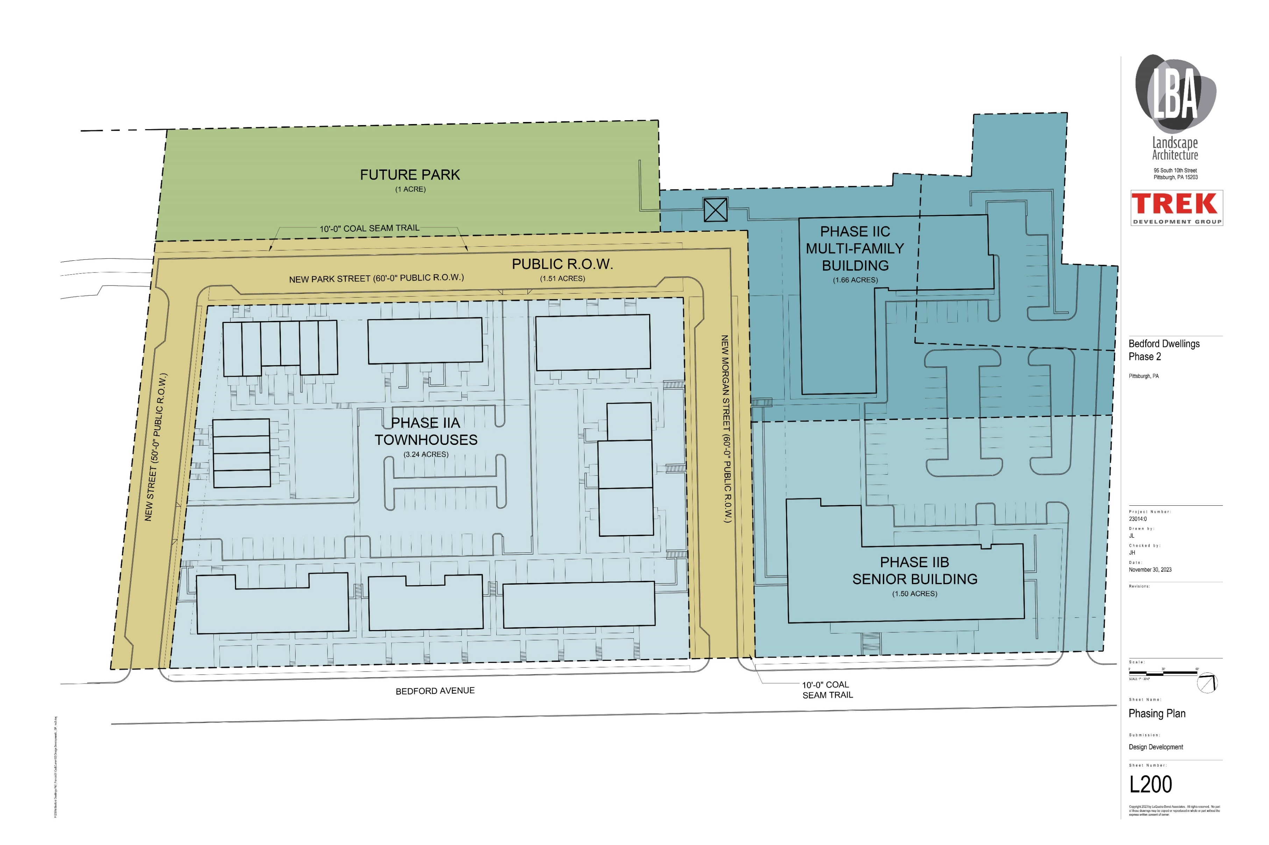
Bus Stop
Notes:
Discussion: Site topography challenges
slopes more than 80’ feet of elevation

Slide 19
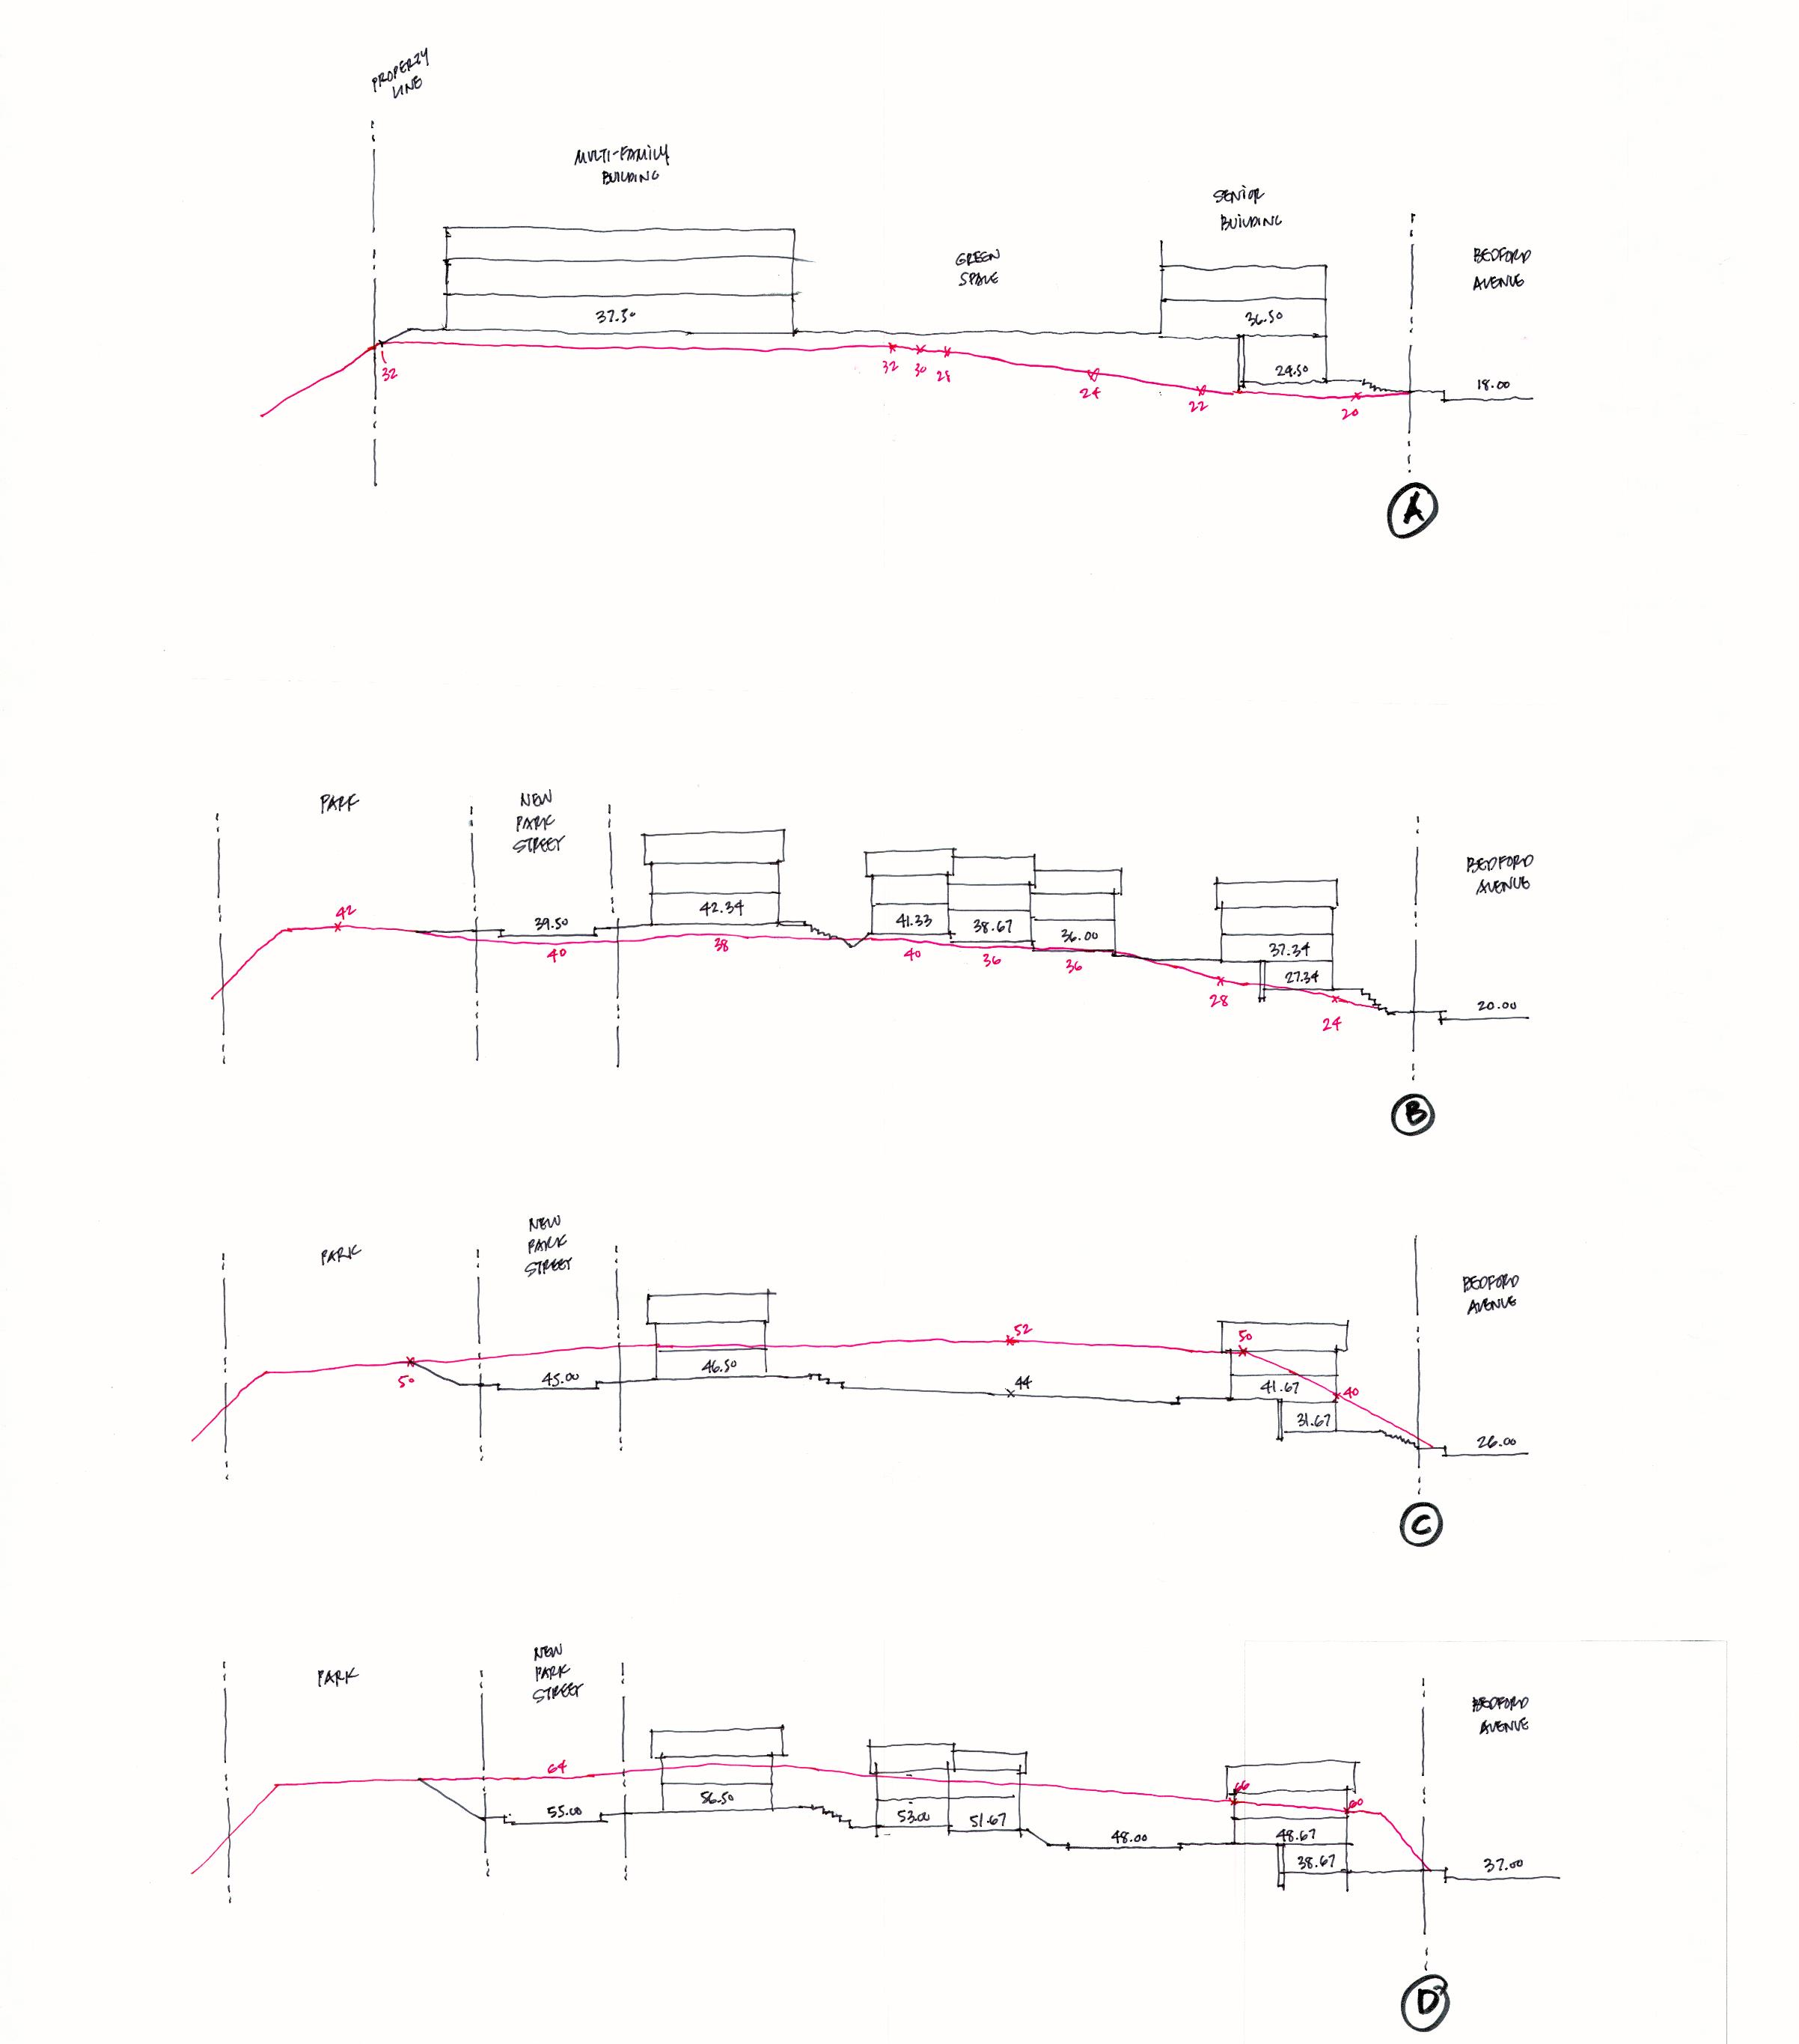
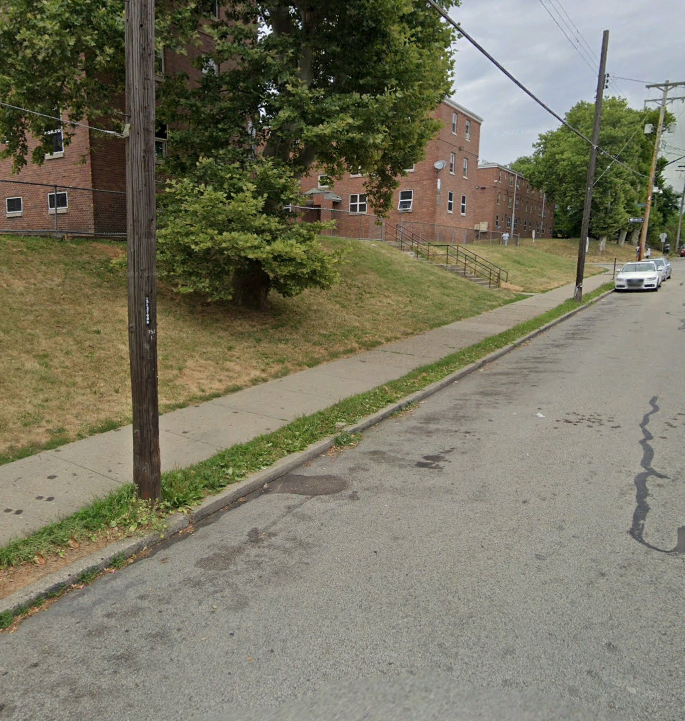
Bedford Dwellings Phase II-
Connection to Bedford Ave
Bedford Dwellings Now-
No Connection to Bedford Ave.

Slide 20
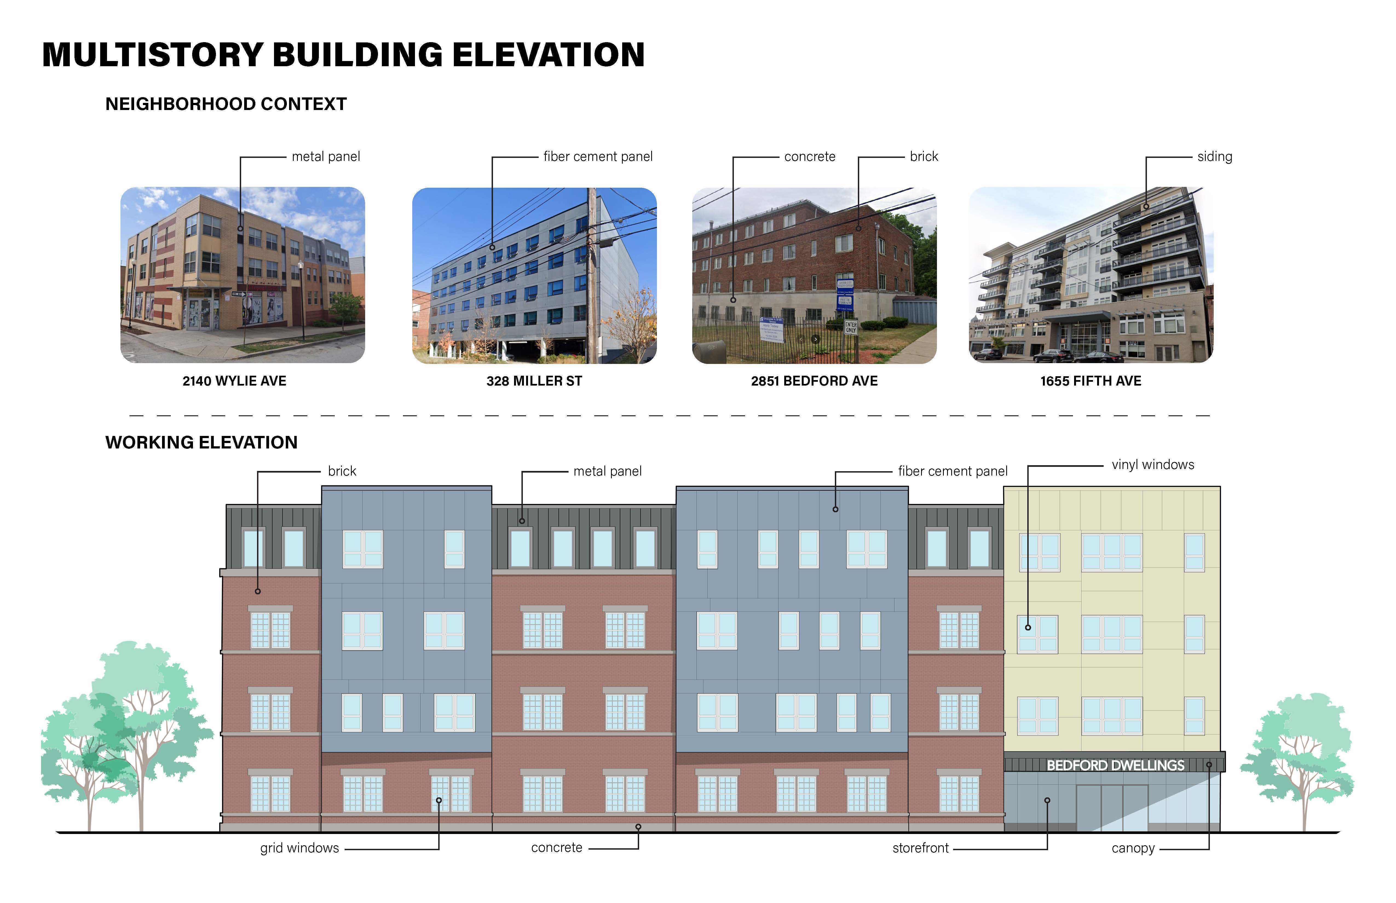
Notes:
Discussion: Architecture/ Building types
- Larger unit types and storage

Slide 21
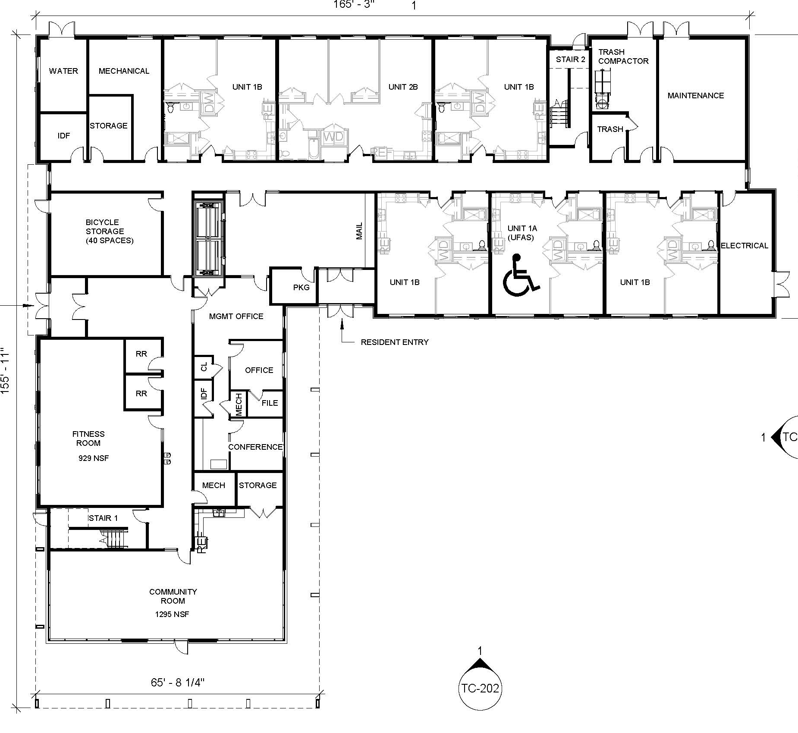
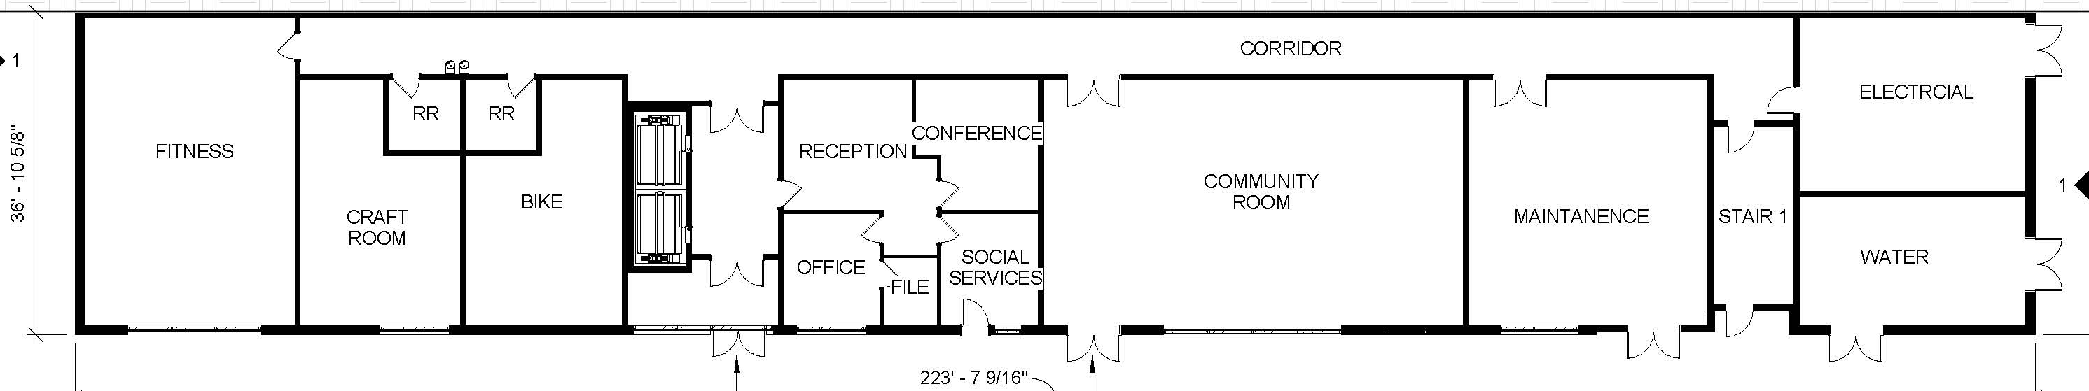
Building Amenity Spaces
Family Amenities
Senior Amenities
Bus Stop

Slide 22
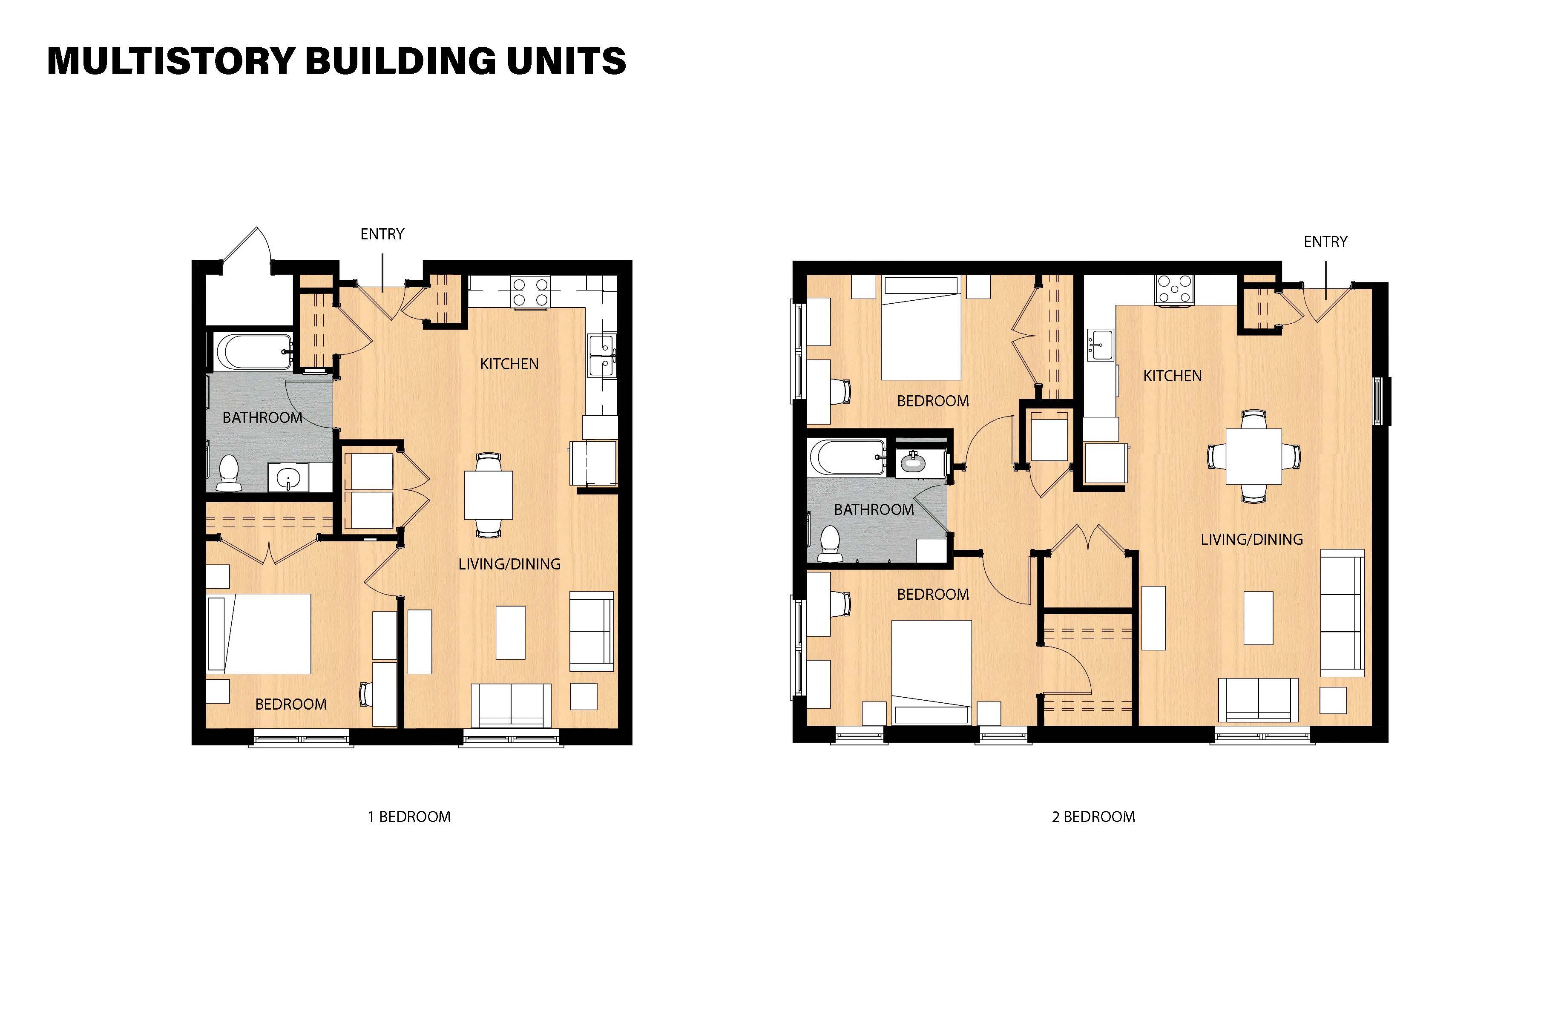
Notes:
Di- Larger unit types and storage
scussion: Architecture/ Building types

Slide 23
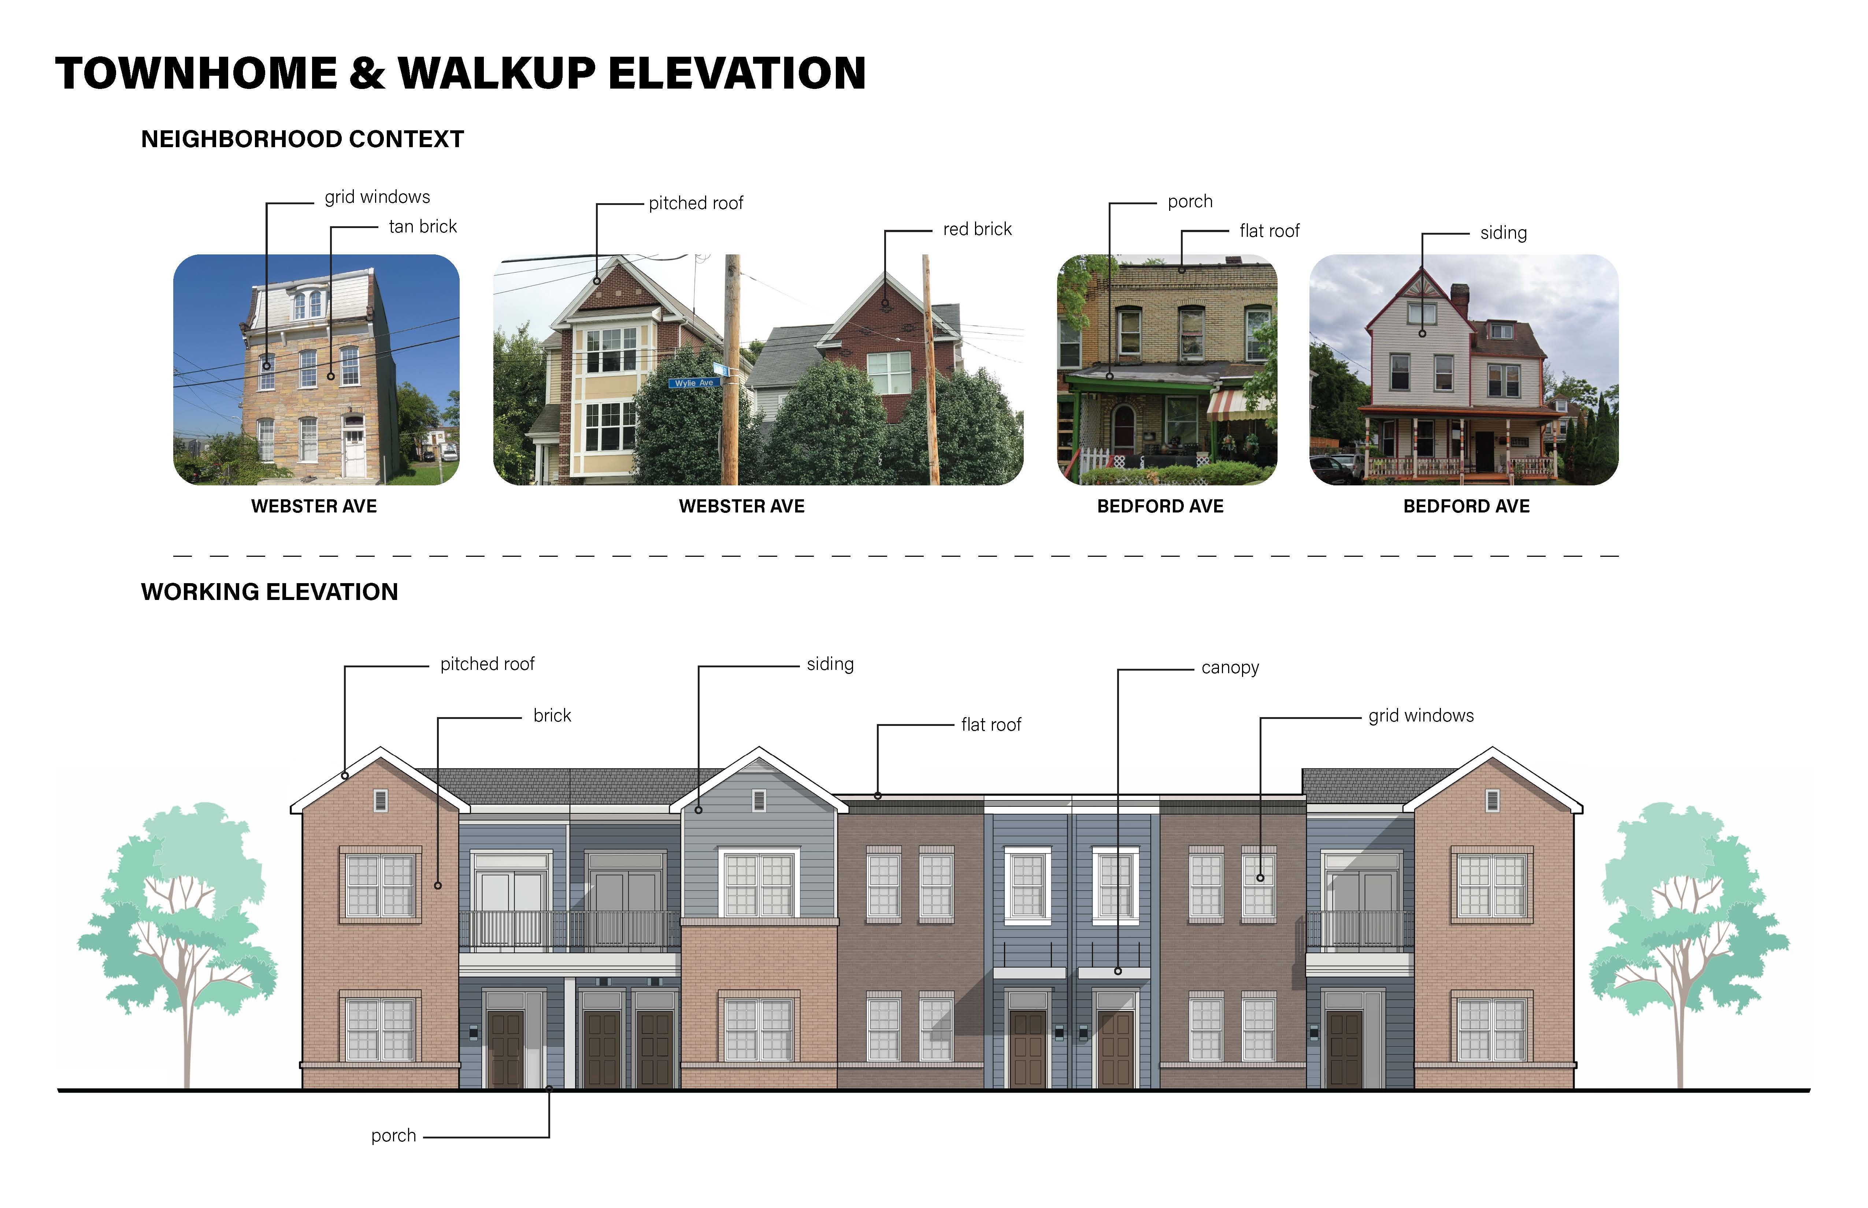
Notes:
Discussion: Architecture/ Building types
- Highlight amenities (more discussion later)
- Larger unit types and storage

Slide 24
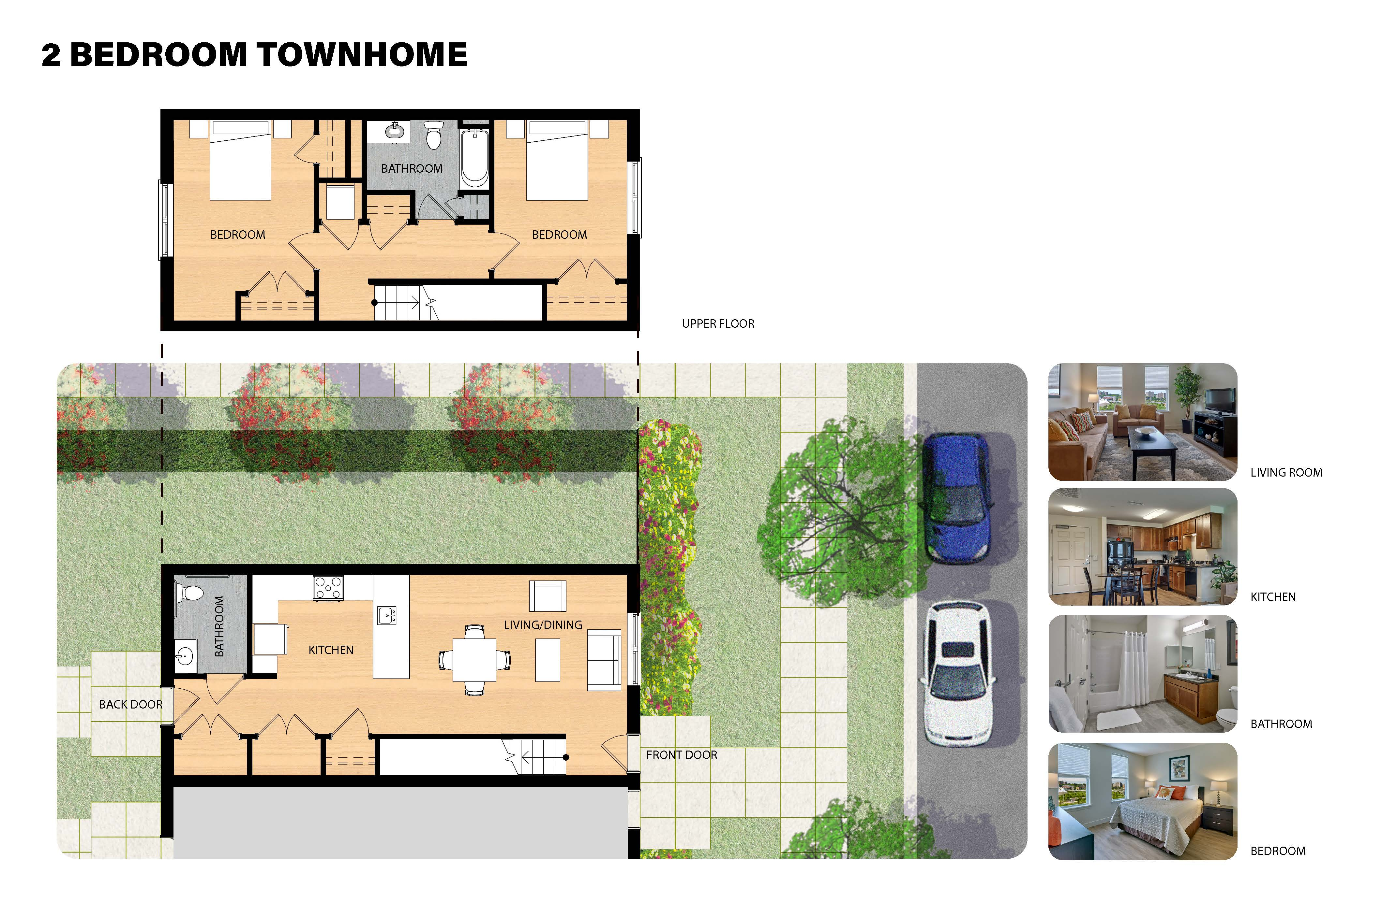
Notes:
Discussion: Architecture/ Building types
- Highlight amenities (more discussion later)
- Larger unit types and storage

Slide 25




SUSTAINABILITY
ENERGY STAR RATED APPLIANCES
HIGH EFFICIENCY HEATING AND COOLING SYSTEMS IN EACH UNIT
HIGH EFFICIENCY WATER HEATING IN EACH UNIT
LED LIGHT FIXTURES IN ALL UNITS
LOW FLOW PLUMBING FIXTURES
NATURAL VENTILATION IN ALL UNITS AND COMMON SPACES
BUILDINGS WILL BE SOLAR READY
ENTERPRISE GREEN COMMUNITIES CERTIFCIATION AND ZERO ENERGY READY
Notes:
Discussion: Green Features of the buildings- much more energy efficient- lower energy bills
meet Energy Star Green Communities program and the US Department of Energy’s Zero Energy Ready Home Program
Commitment to meet or exceed cities stormwater management code- no additional storm run off
Green roofs

Slide 26
BEDFORD DWELLINGS REDEVELOPMENT PHASE II TIMELINE
PENNSYLVANIA HOUSING FINACE AGENCY 9% LOW INCOME HOUSING TAX CREDIT APPLICATION
LEASE-UP ACTIVITY/INITIAL OCCUPANCY
FINANCIAL CLOSING
RELOCATION ENDS
HILL DISTRICT DESIGN REVIEW PANEL MEETING
PENNSYLVANIA HOUSING FINACE AGENCY 4% LOW INCOME HOUSING TAX CREDIT APPLICATION
CONSTRUCTION ENDS
CONSTRUCTION BEGINS
2024
2025
2026
2027

Slide 27


Slide 28
DRP COMMITTEE FEEDBACK/ QUESTION ANSWERS FROM OCTOBER
Do Francis Street residents who were displaced by the demolition many years ago also receive consideration for replacement units?
  The Choice Neighborhoods Implementation (CNI) Grant has specific requirements regarding eligibility for replacement units. Original Residents (as defined by HUD) are tenants residing in a Bedford Dwellings unit at the time of CNI Grant award, which was July 26, 2023. If there are additional replacement units available after all Original Residents have been offered a replacement unit, the wait-list will be handled by the HACP Occupancy department in accordance with applicable Project Based Rental Assistance (PBRA) requirements. As a note, any geographic residency preference can only be county-wide or at the municipality level, which is a HUD rule. Therefore, HACP cannot give any preference to former residents of Francis Street or local Hill District residents.
What will the selection process be for affordable units and market-rate units, and who will make ultimate decisions on how tenants are selected?
  All Original Residents (defined above) will not be subject to a selection process. All residents in good standing with HACP will be eligible for a replacement unit. New tenants in the market rate and affordable units will be subject to the Trek Development Property Management Screening Criteria.
  Will there have to be background checks or any screening?
    The screening criteria includes a background search of rental, credit, and criminal history of up to seven (7) years and determining if rent is affordable for the household.
  Are there certain preestablished qualifications?
    A copy of Trek’s established Screening Criteria is available as requested.
  Will residents be given a lease well in advance for their review?
      Yes
  How are current Bedford Dwellings residents being prepared for their move into new units? How much time do they have to prepare?
    Relocation will not occur until 2026. From now until then, all Bedford Dwellings residents will have access to robust case management services to help them as part of this transition and connect to other supportive services any household may need. The HACP relocation staff will work closely with case management to make the transition as smooth as possible and to prepare residents for what to expect.

Slide 29
DRP COMMITTEE FEEDBACK/ QUESTION ANSWERS FROM NOVEMBER
GHDMP GOAL: Housing Development without Displacement
  Provides quality rental and ownership housing opportunities for a broad range of unit sizes and incomes.
  Answer: Choice Neighborhoods (CN) Housing component is a rental housing program. The Neighborhood plan calls for one of the four Critical Community Improvements (CCIs) to be the development of new home ownership opportunities. In this phase of the development plan, unit sizes range from 1- bedroom to 4-bedroom units. Of the 180 units on site, 103 units will be replacement units for Bedford Dwellings Residents, 44 will be Low Income Housing Tax Credit units affordable for residents from 50%- 80% AMI, and 33 market rate units.
GHDMP GOAL: Economic Empowerment
  Contain retail and commercial use on the first floor; promote ground-level activity.
  Demonstrate a commitment to retain and provide expanded business opportunities for new and existing entrepreneurs.
  The proposed development includes "right to return" preferences for displaced businesses.
  Answer: The CN Neighborhood plan calls for the commercial and street front activation activities along Centre and Heron Avenues. The Urban Redevelopment Authority will work with the Community to curate the retail opportunities and consult with the Hill CDC to work with their HD Rising list of over 80 commercial prospects.
GHDMP GOAL: Make The Hill District a Green and Well-Designed Community
  Promotes usage of high-quality entertainment and open spaces, such as outdoor cafes.
  Answer: A third CCI in the CN plan will be the creation of the “Coal Seem Trail Park”. The concept, born out of the Hill District Greenprint Plan from 2009, will create a public active recreation park along the bluff at Bedford connecting the new development down to Ammons Recreation Center.

Slide 30
PROJECT COMPLIANCE WITH COMMUNITY GOALS
Address Historical Wrongs
No Displacement of residents
All units are 1 for 1 replacement with and will be affordable in perpetuity.
First Source Hiring Provisions and HUD Section 3 Compliance
Development team is committed to Davis Bacon Wage rates and Section 3 requirements.
Development contracts to meet a minimum of 30% MBE participation and 15% WBE participation
Development team is committed to MBE/WBE compliance.
Reflect Neighborhood Driven Civic Design
Resident access to parking and roadways
The site will have off-street parking options for tenants and will reintegrate the street grid into the site.
Design recognizes that the Hill District is primarily a residential neighborhood
The development plan is a new mixed-income residential development with space for a new park.
Development plans benefit existing and future community residents while allowing for future growth
The design also strives to be sensitive to the existing neighborhood fabric mirroring the height and density of the community and integrating into the existing street grid in order to energize the streets. Part of the site will be developed to be a public park as part of the Choice Neighborhood Implementation Grant.
Notes:
Discussion: For the conclusion to show how we are meeting the goals of the community with the development
* Need to note- - Site will be requesting City approval from the Planning Commission and could require approval from the Zoning Board of Adjustment

Slide 31
PROJECT COMPLIANCE WITH COMMUNITY GOALS (Cont.)
Promote a Green and Healthy Environment
Plans include provisions for green and sustainable development
This development will be sustainable and will meeting the Energy Star Green Communities program and the US Department of Energy’s Zero Energy Ready Home Program.
Design preserves views from the Hill District in all directions
Development will maintain views and will allow for selective additional views over the bluff to the Strip District and Allegheny River.
Renter Support
No displacement of Residents
Residents will be relocated from Bedford Dwellings. All units will be replaced 1 for 1 with no loss of affordability.
The redevelopment plan for Bedford Dwellings to a new mixed-income community
Francis Street will be approximately 57% Replacement, 24% Additional Affordable and 18% Market- Rate Housing.
Notes:
Discussion: For the conclusion to show how we are meeting the goals of the community with the development
* Need to note in discussion- - Site will be requesting City approval from the Planning Commission and could require approval from the Zoning Board of Adjustment

Slide 32
PROJECT COMPLIANCE WITH COMMUNITY GOALS (Cont.)
Non-Displacement Strategies
Developers will meet with a Hill District-based employment center to meet mutually agreed upon hiring goals
Developer must meet HUD section 3 requirements and agrees to partner with a local employment Center.
Developers are committed to meet 30% MBE participation and 15% WBE participation
Development team is committed to MBE/WBE compliance.
Eminent domain will not be used to acquire properties
Eminent Domain has not and will not be used to acquire any properties.
Preserving Affordability
Greater than 30% of the units will be available to residents at or below 50%
45% of the units will be available to residents at or below 50% AMI.
The development preserves the project based rental subsidy
All Bedford Dwellings replacement units will maintain affordability through PBV subsidy and HACP land ownership to maintain affordability indefinitely.
Notes:
Discussion: For the conclusion to show how we are meeting the goals of the community with the development
* Need to note in discussion- - Site will be requesting City approval from the Planning Commission and could require approval from the Zoning Board of Adjustment

