Slide 1
HILL HOUSE RFP RESPONSE & DEVELOPMENT
Community PRESENTATION
March 26th 2019

Slide 2
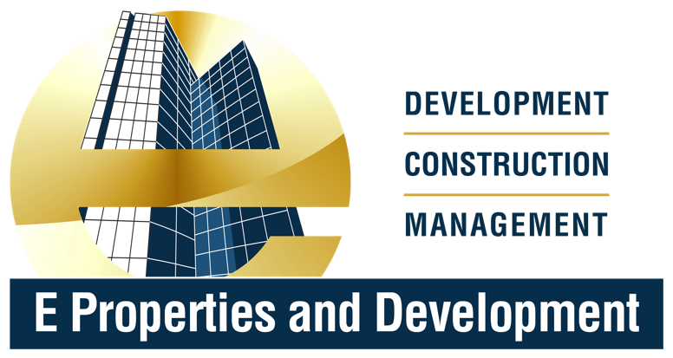
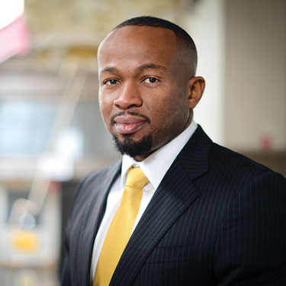
TEAM
E Properties and Development, a Pittsburgh-based development company was founded in 2009. Since our inception, we have completed over $25M worth of developments and currently own and manage 100+ distinctive rental units throughout the city of Pittsburgh. E Properties and Development offers a complete spectrum of services to develop, redevelop, finance, lease and manage commercial and residential properties. Our focus lies in the development and redevelopment of underperforming assets. We utilize the latest and most efficient construction techniques to create the highest value for our buyers, investors and the community. We believe we are redefining real estate development and setting a higher standard for other developers.
Emeka Onwugbenu
(Eh.meh.ka On.woo.bay.nu)
Founder and CEO
Notes:
Emeka

Slide 3
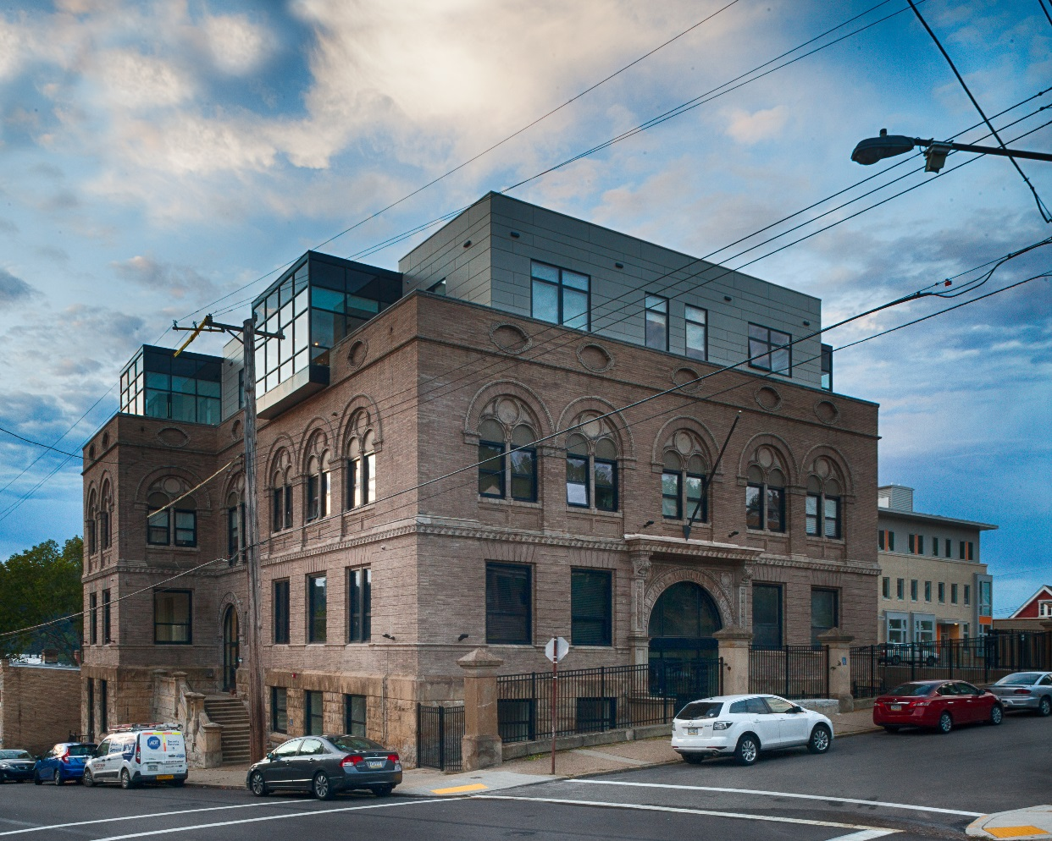
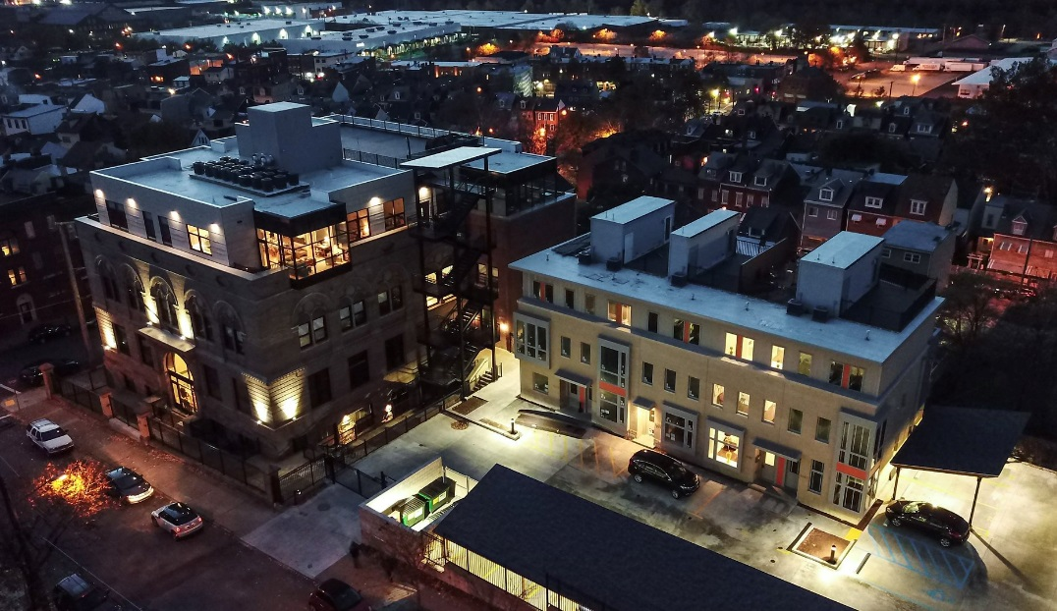
Previous Projects
McCLEARY SCHOOL
  Conversion of a former Pittsburgh Public School into 25 residential units, totaling 40,000 SF
  Total development budget of $6.7 Million
  E Properties and Development was the Developer and General Contractor
Notes:
Emeka

Slide 4
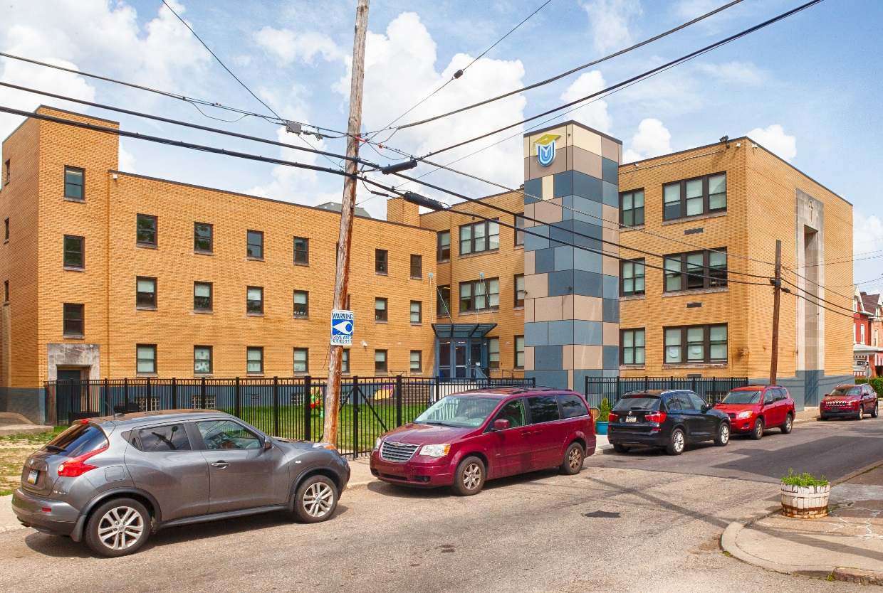
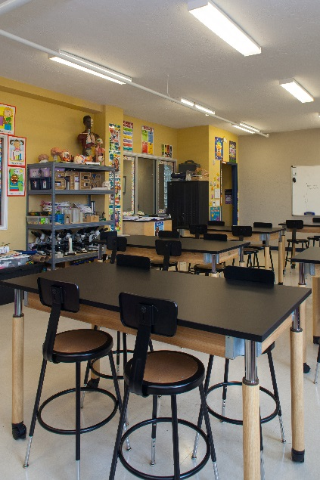
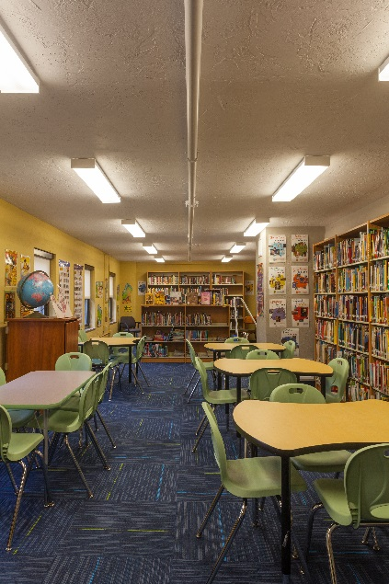
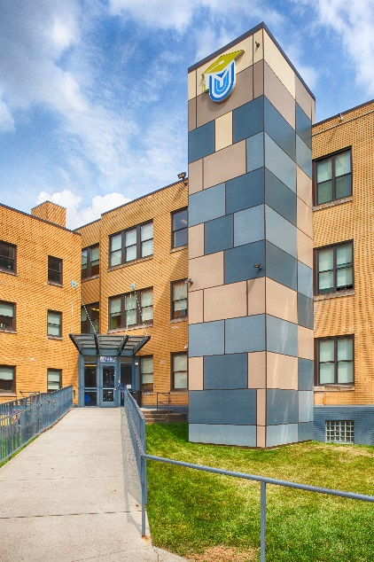
Previous Projects
URBAN ACADEMY BUILDING
  38,000 SF education facility that houses the Urban Academy of Greater Pittsburgh Charter School
  Total development budget of $3.1 Million
  E Properties and Development was the Developer, General Contractor and Property Manager
Notes:
Emeka

Slide 5
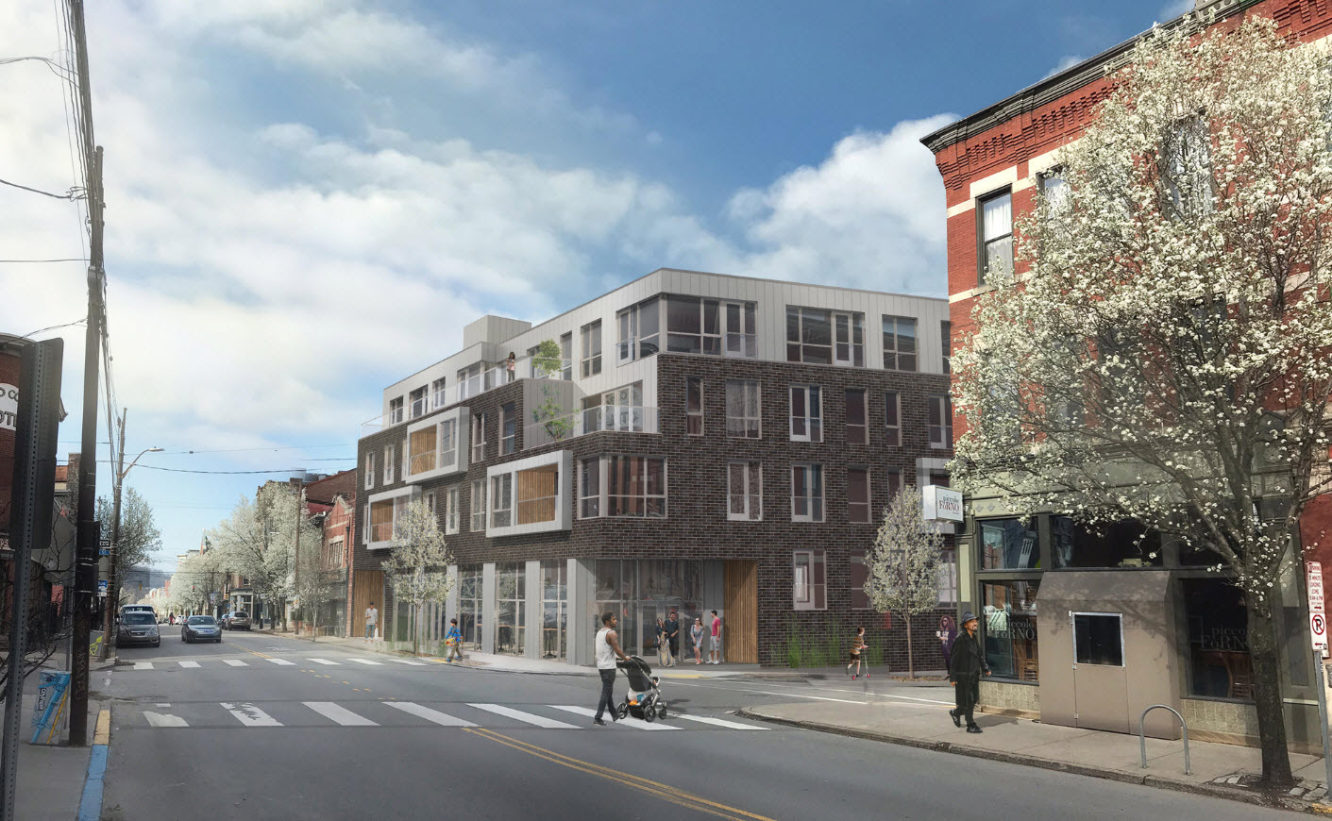
Current Projects
LAWRENCEVILLE LOFT
  46,000 SF mixed use and
  25 residential units, retail, parking, roof top, roof garden, wine room
  Mixed income condo building
Before After
Notes:
Emeka

Slide 6

COMMUNITY PARTNER & TEAM MEMBER
  The Hill Community Development Corporation (Hill CDC) is the go-to community development agency in the Hill District neighborhood. Residents, elected officials and stakeholders look toward the Hill CDC’s support as the gold standard for projects that align with the Greater Hill District Masterplan, the community’s endorsed vision for the Hill District.
  Founded in 1987, the Hill CDC has been a catalytic force of redevelopment within the Hill District community for over 30 years. Key residential developments over the years include: Crawford Square, Loendi Townhouses, Wylie Ave Townhouses, the first phase of Dinwiddie Townhouses and Bedford Hill apartments; as well as commercial developments such as Williams Square and One Hope Square. The Hill CDC has developed, partnered and facilitated the development of over 1,000 residential units and over 20,000 square feet of commercial/retail space.
  These developments gave rise to the development activity witnessed in today’s Hill District. Since founded, the Hill CDC has worked to improve the quality of life for Hill District residents by providing resident support, business programming, technical assistance, project facilitation, program design and more to further the development of a strong, diverse, economically self-sustaining neighborhood.
Notes:
Marimba

Slide 7
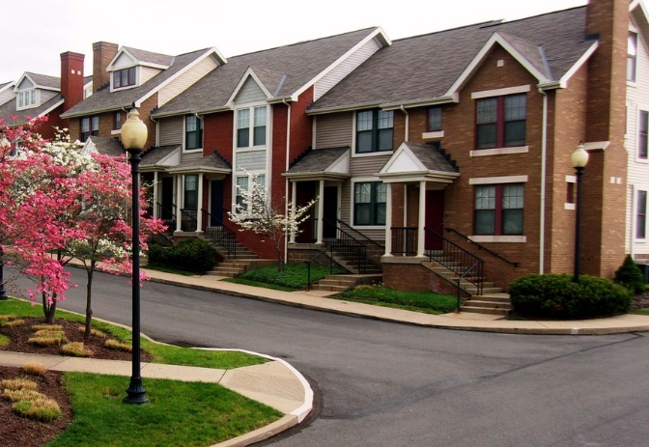
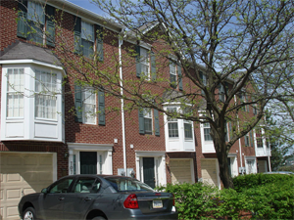
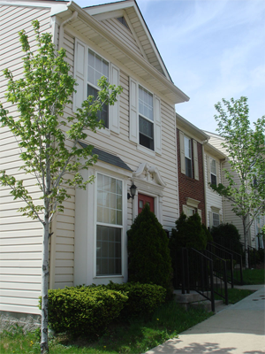
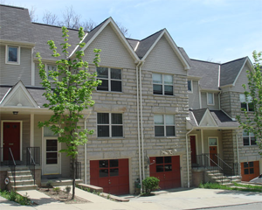
Previous Projects
CRAWFORD SQUARE APARTMENTS
  Limited partner with McCormick Baron Salazar for the construction of Crawford Square
  424 units for sale and rental
LOENDI TOWNHOMES
  Developer of ten townhome units for moderate-income families on Arcena Street
WYLIE AVE RENTAL TOWNHOMES
  Construction of twelve new for-sale townhomes and twenty-four rental units on Wylie Avenue for moderate income families.
DINWIDDIE FOR-SALE TOWNHOMES
  Developer of six townhomes for moderate-income families. Phase II construction of six to eight additional townhomes currently in process.
Notes:
Marimba

Slide 8
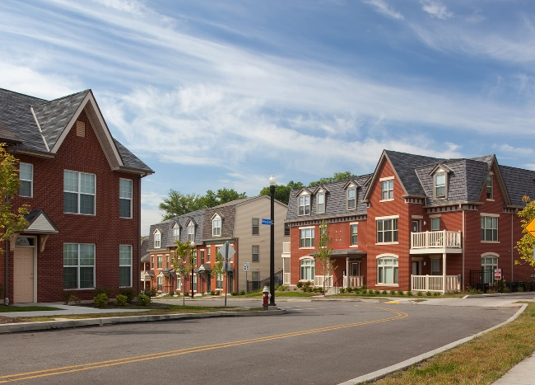
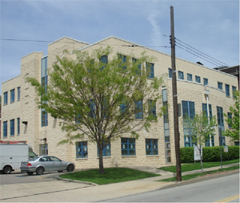
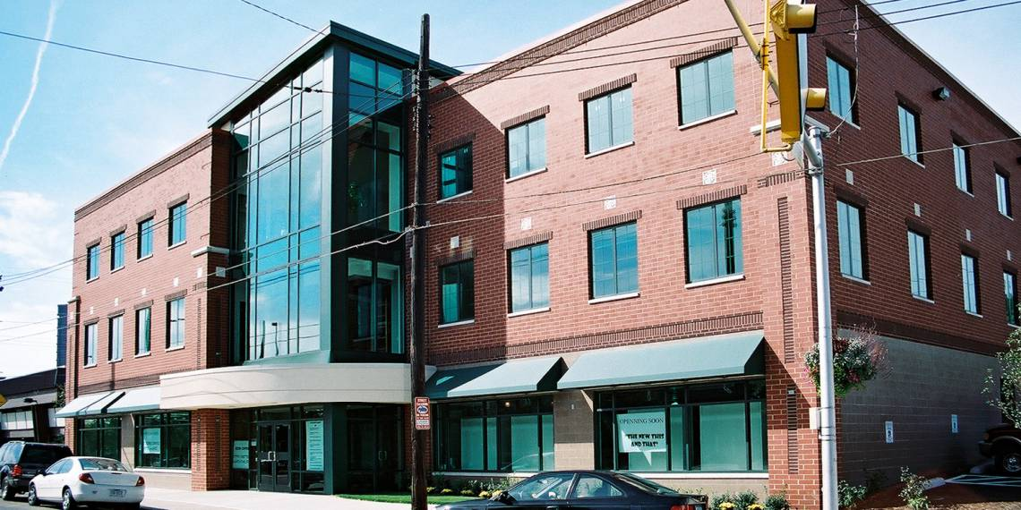
Previous Projects
BEDFORD HOPE VI PROJECT
  Partnered with Housing Authority of the City of Pittsburgh, Hill CDC & McCormack Baron
  Over 500 rental and for-sale units of mixed-income housing
WILLIAM SQUARE
  Promoted and facilitated development of mixed-use professional office building
ONE HOPE SQUARE
  Promoted and facilitated the development of mixed use office and retail building
Notes:
Marimba

Slide 9
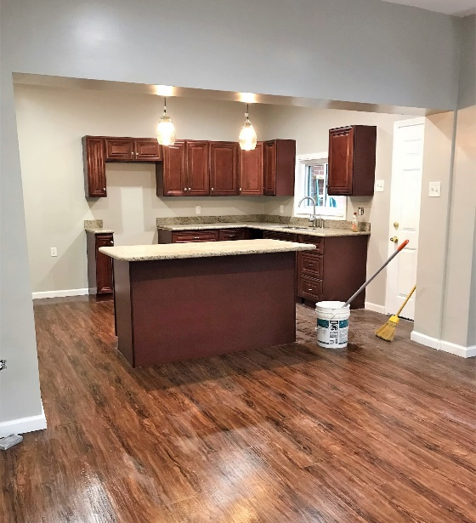
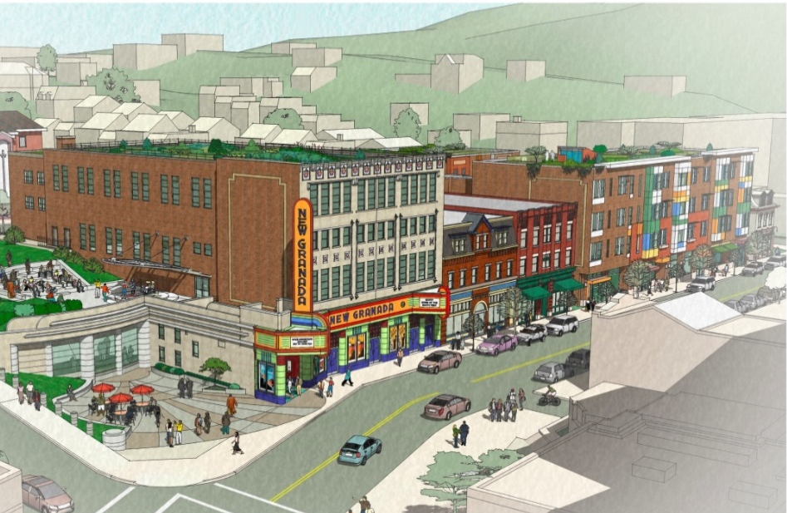
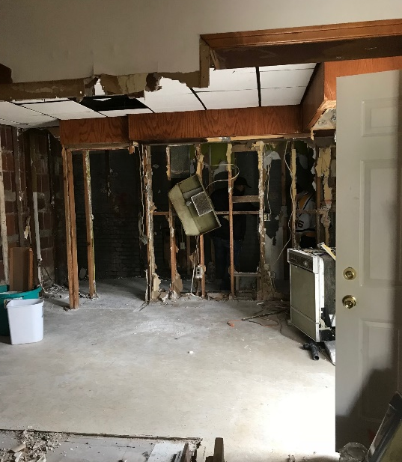
Current Projects
Before After
HILL DISTRICT 100
  Initiative of the Hill CDC to provide relevant and meaningful education and support to potential home buyers to systematically grow the Hill District, using rehabilitated blighted properties
  Completed 3 successful rehabs
  19 more in the pipeline
NEW GRANADA SQUARE DEVELOPMENT
  50,000 SF of commercial space including Class A office spaces, retail, café event spaces.
  University of Pittsburgh as the anchor tenant
  40 mixed-income apartments
Notes:
Marimba

Slide 10
COMMUNITY CENTERED APPROACH
  Honor community needs via proper engagement
  Review of existing documents and information
  Identify strategic partners and tenants to support the needs of the community
  Effective property management for a good tenant experience
  One on one meetings with each tenant
Notes:
Marimba

Slide 11
ALIGNS WITH HILL DISTRICT MASTER PLANS
  Promote Economic Justice
    All development plans must include first source hiring provisions within the project labor agreements for all stages of work at any development site.
    All development contracts must require a minimum MBE participation rate of 30% and WBE participation rate of 15%.
  Promote a Green and Healthy Environment
    Improvements to the buildings promotes Green and Healthy Environment, with focus on energy efficient, green and sustainable systems.
    The reuse of all four properties, without demolition, is the optimal sustainable approach
  Build Upon the African American Cultural Legacy
    The placements of signage, sign post and walking trails, shall honor the historical and cultural legacy of the Hill District.
    Partner with Hill District Artist to create a mural on One Hope Square
  Community Ownership
    Hill CDC shall provide approximately 15% of the required equity for acquisition with the option to increase community ownership for the redevelopment
Building Upon African American Cultural Legacy | Make Hill District A Green and Well Designed Community
Economic Empowerment | Development without Displacement | Mobility, Transportation and Parking
Notes:
Marimba

Slide 12
DEVELOPMENTS

Slide 13
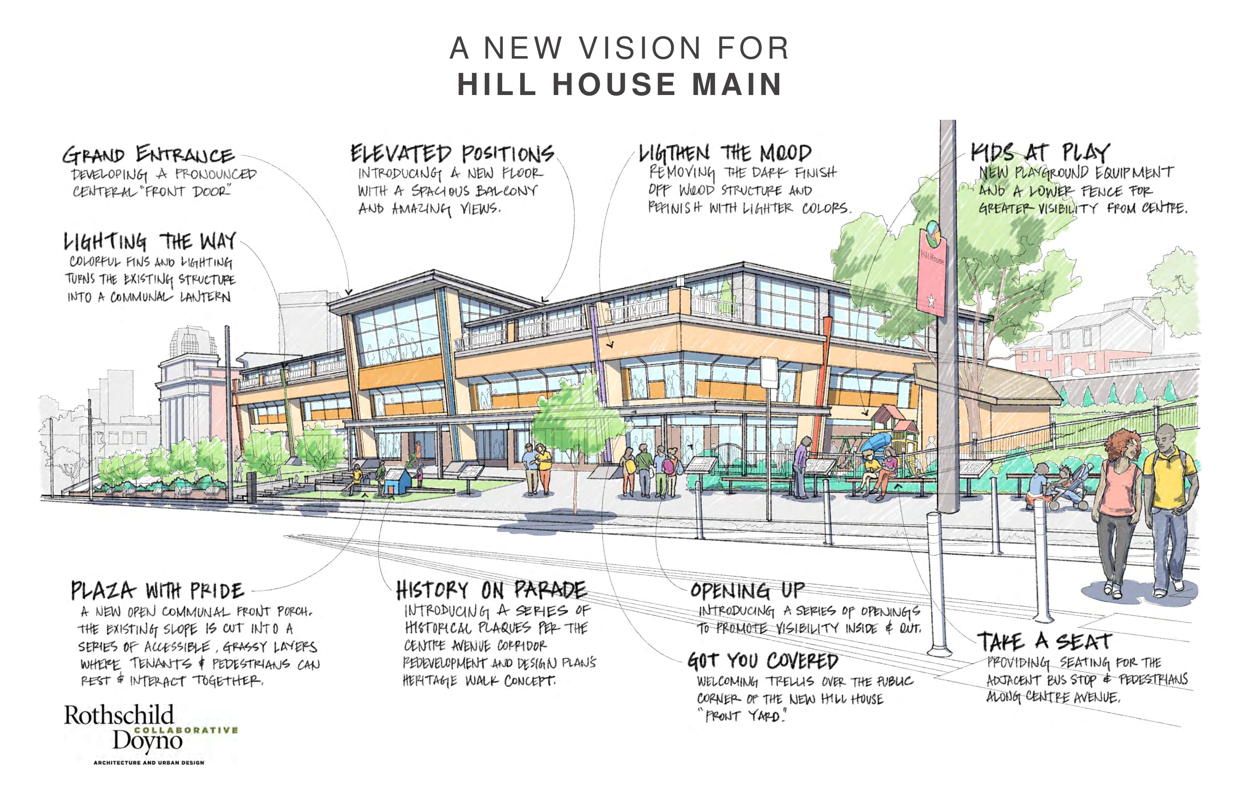
Notes:
Dan

Slide 14
HILL HOUSE MAIN
  Add third floor to preserve the existing structure and respect the history of Hill House
  New MEP systems will assure proper building performance and comfort for tenants
  Add windows on the first floor to better connect the building to Centre Avenue
  Activate the courtyard between the building and Centre avenue to create sitting/meeting areas for Hill District residents and visitors
  Signpost would be placed along the courtyard to create a “past, present and future” heritage walk
  Plans will be advanced to enhance existing parking to support increased use of the facility
  Lease additional space to community partners to strengthen the social service ecosystem within the Hill District
  Meet with individual tenants to understand their needs
  Hill House Association will continue to utilize its current space for 2 years at no cost to Hill House Association
Building Upon African American Cultural Legacy | Make Hill District A Green and Well Designed Community
Economic Empowerment | Development without Displacement | Mobility, Transportation and Parking
Notes:
Emeka

Slide 15
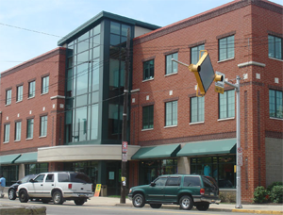
OTHER DEVELOPMENTS
ONE HOPE SQUARE
  Meet with individual tenants to understand its needs
  Improve the MEP system, with focus on energy efficiency, green and sustainable systems.
  Improve the building’s ongoing maintenance, security and cleaning process
  Additional square footage may be considered in the future
  Project to incorporate solar panels on the roof to address high electric consumption costs.
  Partner with Hill District artists to create a mural on the left side facing the pedestrian parkway
Building Upon African American Cultural Legacy | Make Hill District A Green and Well Designed Community
Economic Empowerment | Development without Displacement | Mobility, Transportation and Parking
Notes:
Emeka

Slide 16
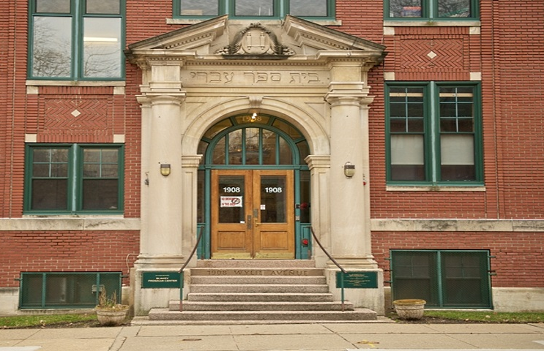
DEVELOPMENTS
BLAKEY CENTER
  Support Hill District-based businesses, as well as event/flex space in alignment with the GHDMP program initiatives.
  Identify the ideal tenant to occupy the available space in the building.
  Meet with the tenant to understand its needs
  Improve the MEP system, with focus on energy efficiency, green and sustainable systems.
  Improve the building ongoing maintenance, security and cleaning
  Accent lighting will be added to compliment the Kauffman Center and draw visitors to the Hill District.
  Improve the parking lot
Building Upon African American Cultural Legacy | Make Hill District A Green and Well Designed Community
Economic Empowerment | Development without Displacement | Mobility, Transportation and Parking
Notes:
Emeka

Slide 17
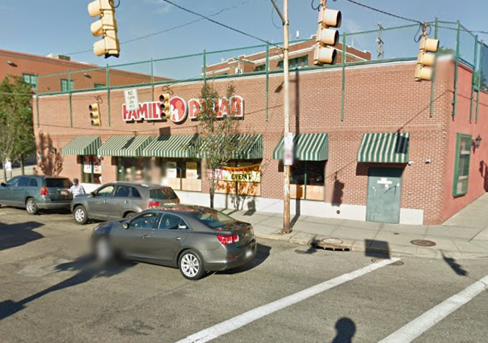
DEVELOPMENTS
FAMILY DOLLAR
  Meet with the tenant to understand its needs
  Improve MEP system, with focus on energy efficiency, green and sustainable systems.
  Accent lighting will be added to compliment the Kauffman Center and draw visitors to the Hill District.
Building Upon African American Cultural Legacy | Make Hill District A Green and Well Designed Community
Economic Empowerment | Development without Displacement | Mobility, Transportation and Parking
Notes:
Emeka

Slide 18
THANK YOU!

Slide 19
Items Discovered After RFP Submission
Building Condition
  Our team was granted access to all four buildings, ONLY after our bid was submitted.
Tenant Lease Termination
  Several tenants have terminated their leases
  A few have no intention of returning to the building
Vacant Building
  No tenants paid rent for the months of February and March
Water Leak Repair
  Extent of water damage unknown. Work is still ongoing
Family Dollar?

Slide 20
Estimated Schedule
March 2019 to May 2019
Jun 2019 to Sep 2019
Building Assessment
Oct 2019 to Dec 2019
Preliminary Design
One-On-One with each tenant
Community Workshops
Jan 2020 to March 2020
Design Development
Construction Documents
April 2020 to Dec 2020
Building Improvements
Community & Court Approval
Building Purchase
Inspections & Appraisals
Initiate Building Maintenance

