Slide 1

MILLER – REED FOR SALE DEVELOPMENT
HILL District Community Meeting – January 19, 2017

Slide 2
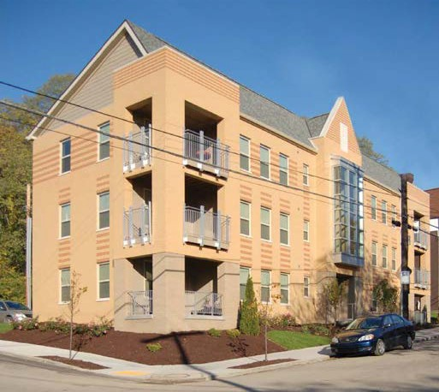
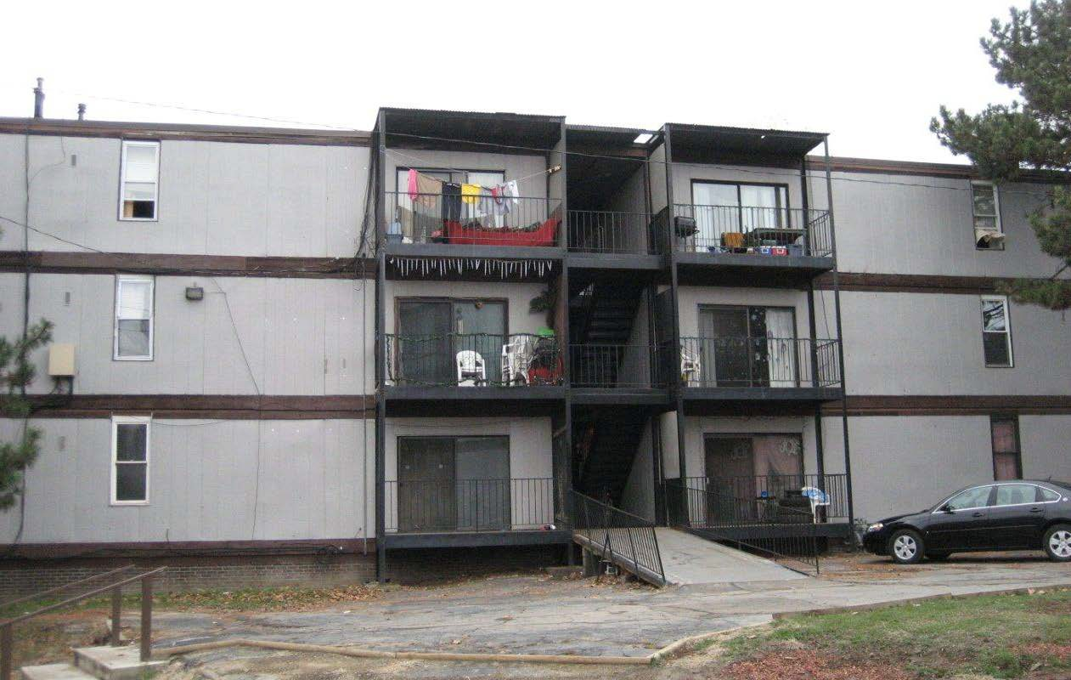
Dinwiddie Street Phases I-IV
95 Rental Housing Units;
$40m Investment
TREK acquired the Reed Roberts Housing Complex to demolish the nuisance property and rebuild affordable housing within the existing street grid along Dinwiddie, Miller & Reed Streets. The completed project presents a harmonious mix of new & renovated structures that create impactful transformation. Recognizing the importance of historic preservation to a neighborhood’s identity,
seven existing structures were included in the Dinwiddie project.

Slide 3
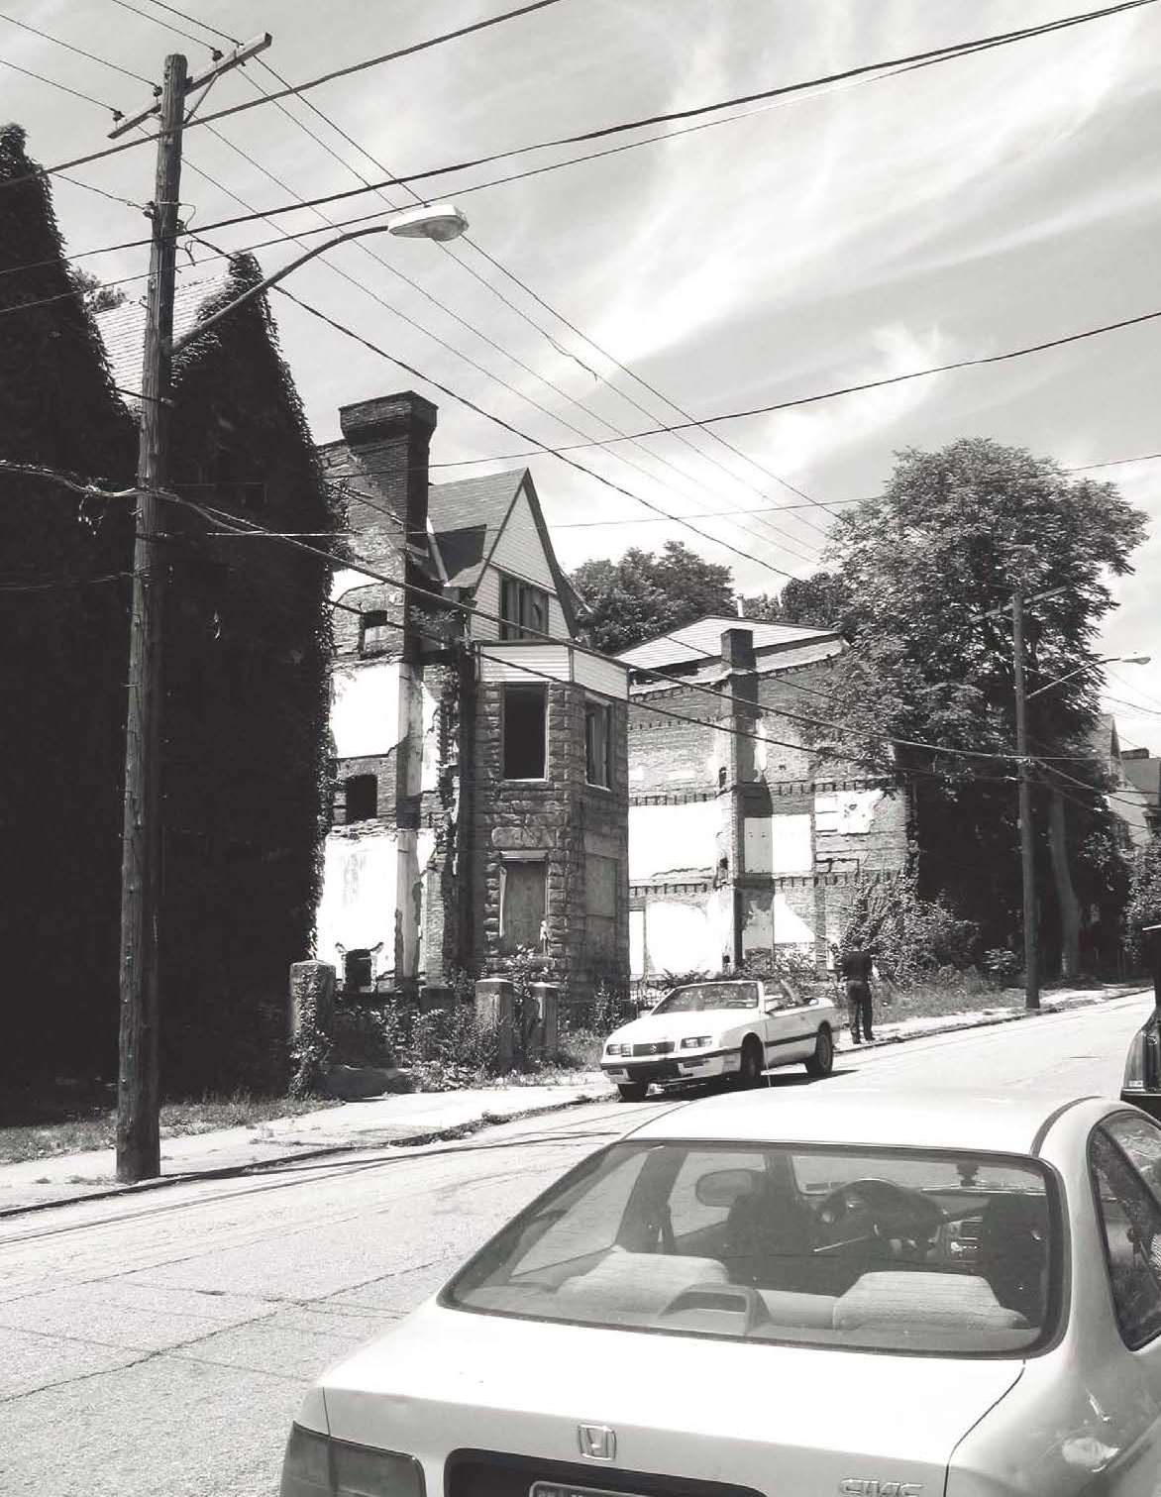
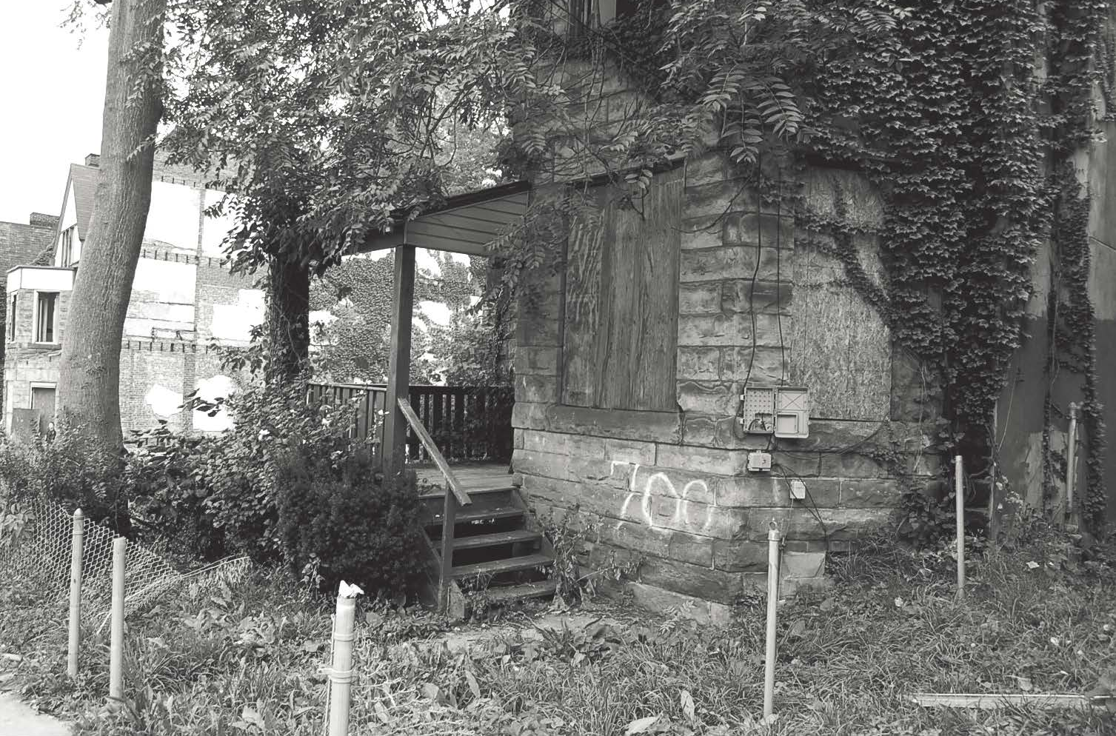
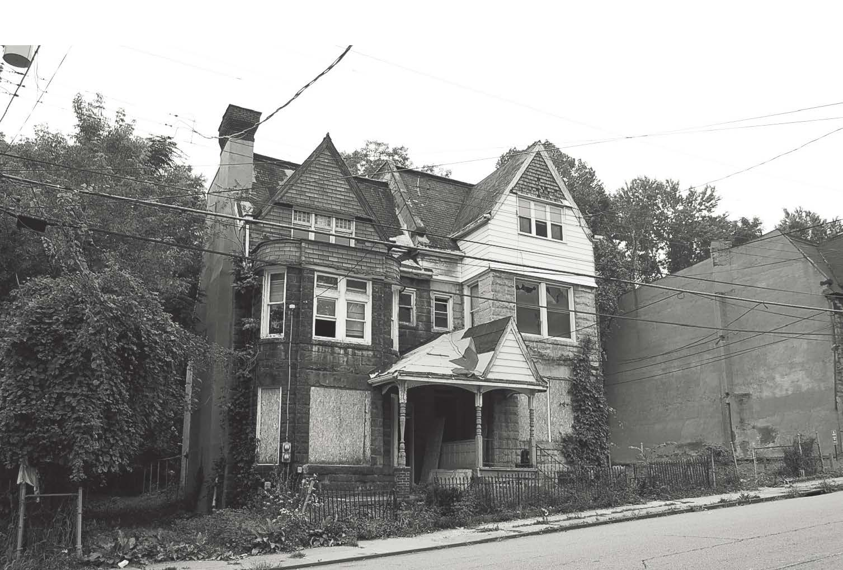
Dinwiddie Street Redevelopment –
Prior Conditions

Slide 4
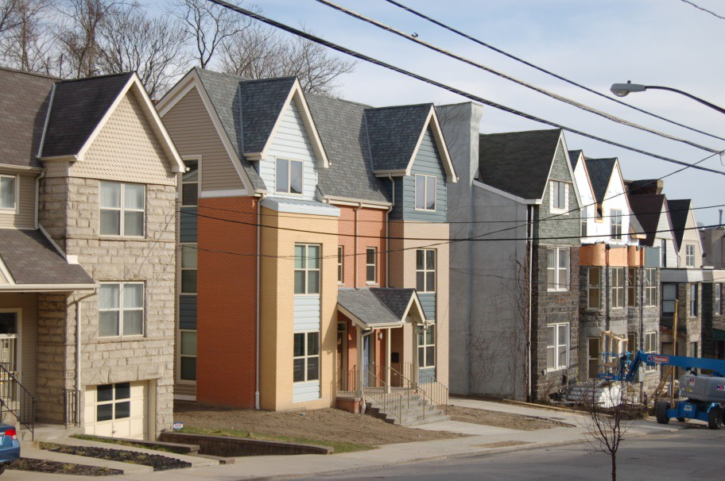
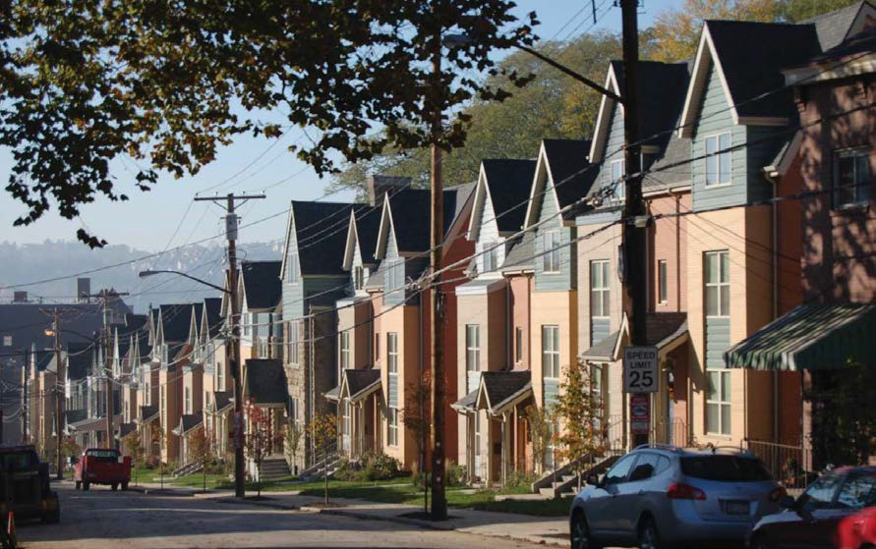
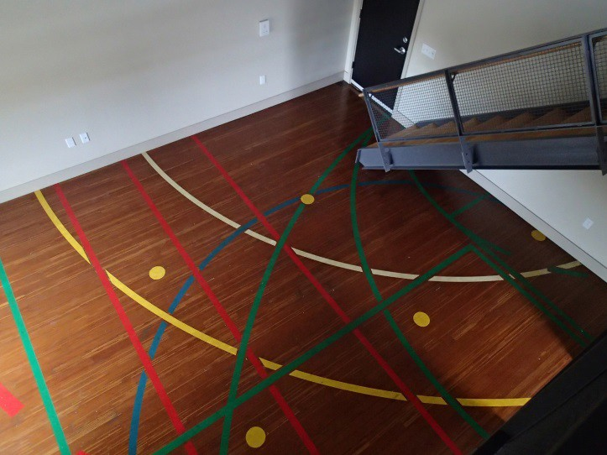
Dinwiddie Street Phases I-IV
95 Rental Housing Units; $40m Investment
Phase IV completed the transformation from a strip of abandoned buildings and vacant lots into a vibrant community. In response to community priorities, TREK has dedicated 35 of the 95 units to convert to for- sale residences after the 15 year Low Income Housing Tax Credit compliance period.

Slide 5

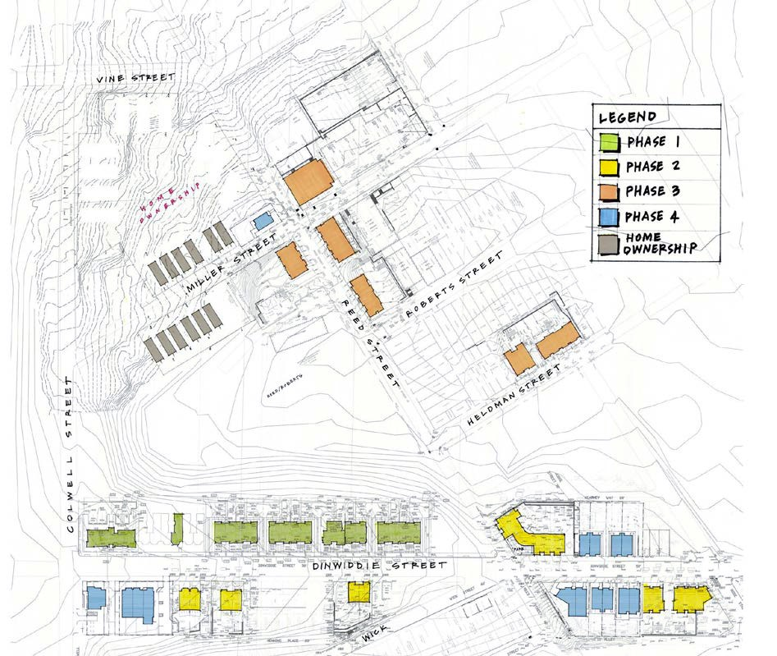
MILLER – REED FOR SALE DEVELOPMENT
Miller-Reed will add a market rate component to TREK’s successful affordable rental development, Dinwiddie Street Phases I-IV, located in the Crawford Corridor district. The inclusion of homeownership will advance the goal of an integrated, stable neighborhood that is inclusive of both rental and homeownership opportunities available to a range of income levels.

Slide 6

MILLER-REED
Development Review Panel Comments/Questions
Affordability – One of the Five homes will be affordable at a price point of $160,000 through the use of a deferred mortgage through the URA.
MBE / WBE Participation - TREK is working with a minority sub-contractor and Project RE to design and build a more affordable unit that can be replicated in future phases.
Exterior Colors – TREK and its architect will work with the DRP to select a color scheme for the new units.
Dinwiddie Street Affordable For Sale – TREK will work with the Hill CDC to transition the rental units to homeownership.

Slide 7
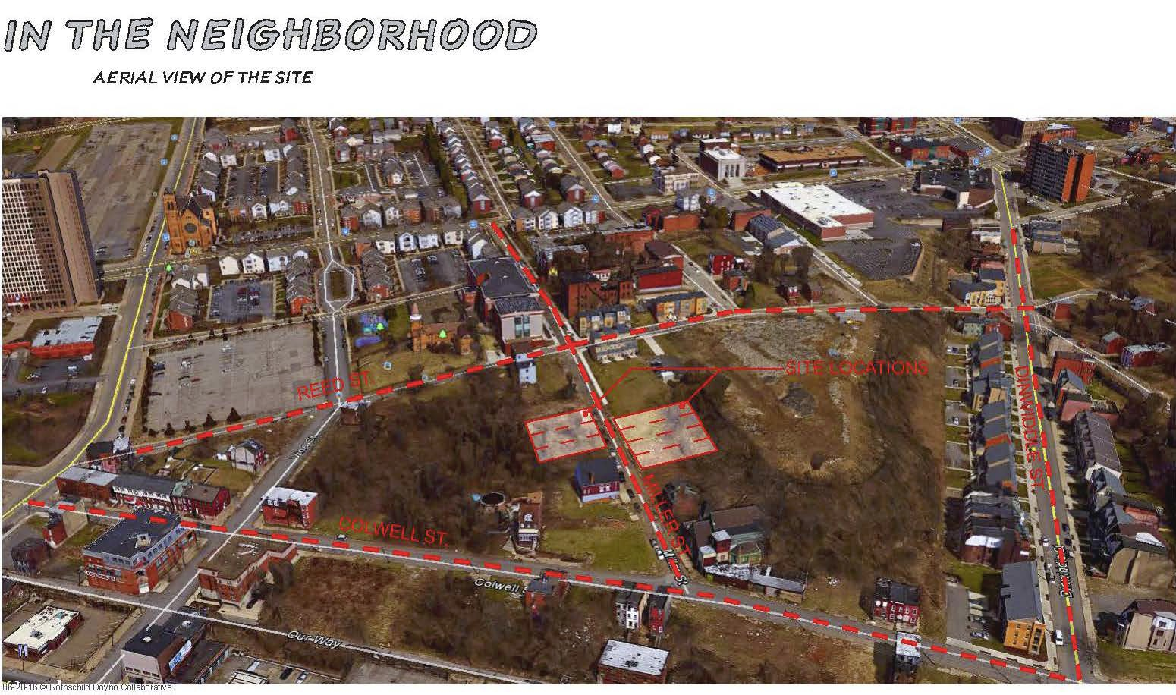
MILLER – REED FOR SALE DEVELOPMENT

Slide 8
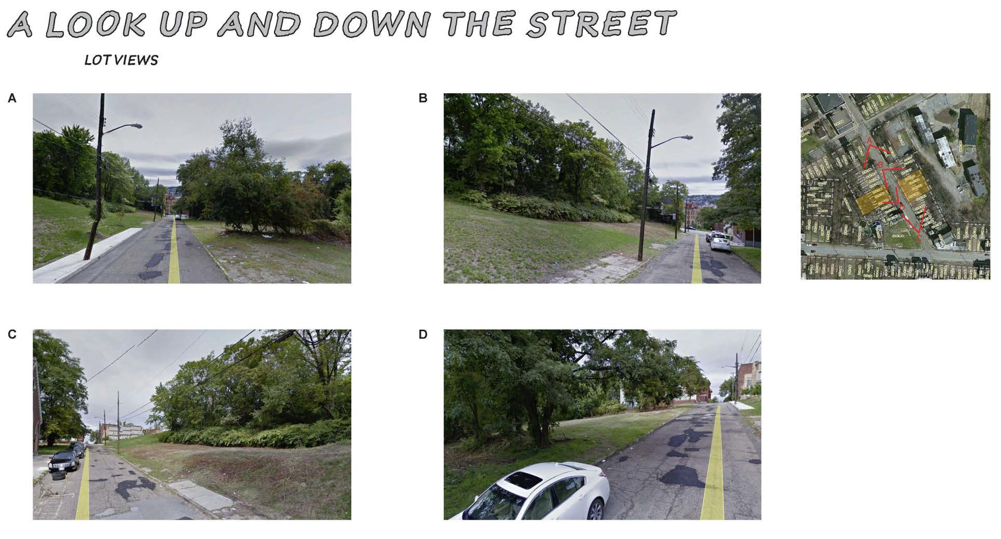
MILLER – REED FOR SALE DEVELOPMENT

Slide 9
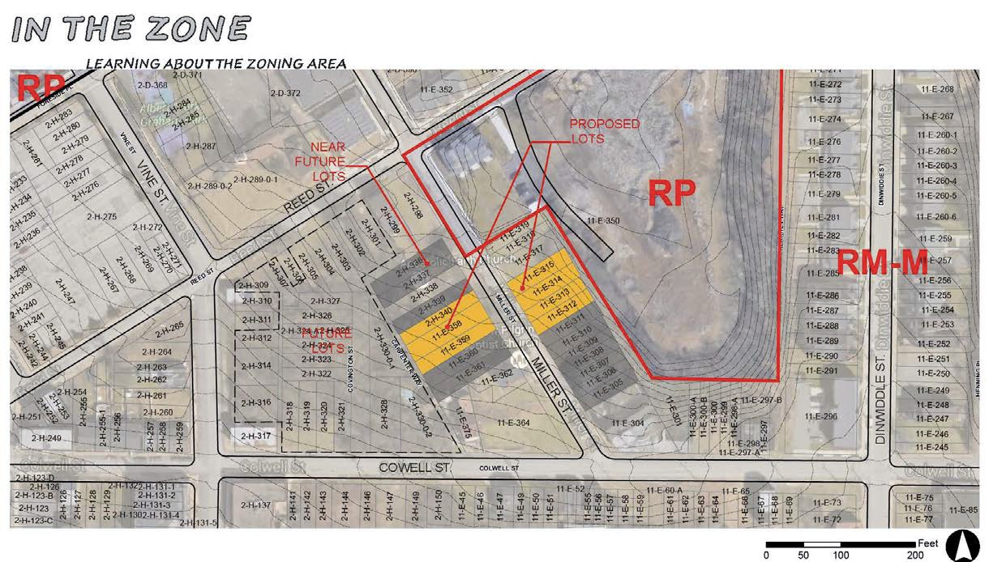
MILLER – REED FOR SALE DEVELOPMENT

Slide 10
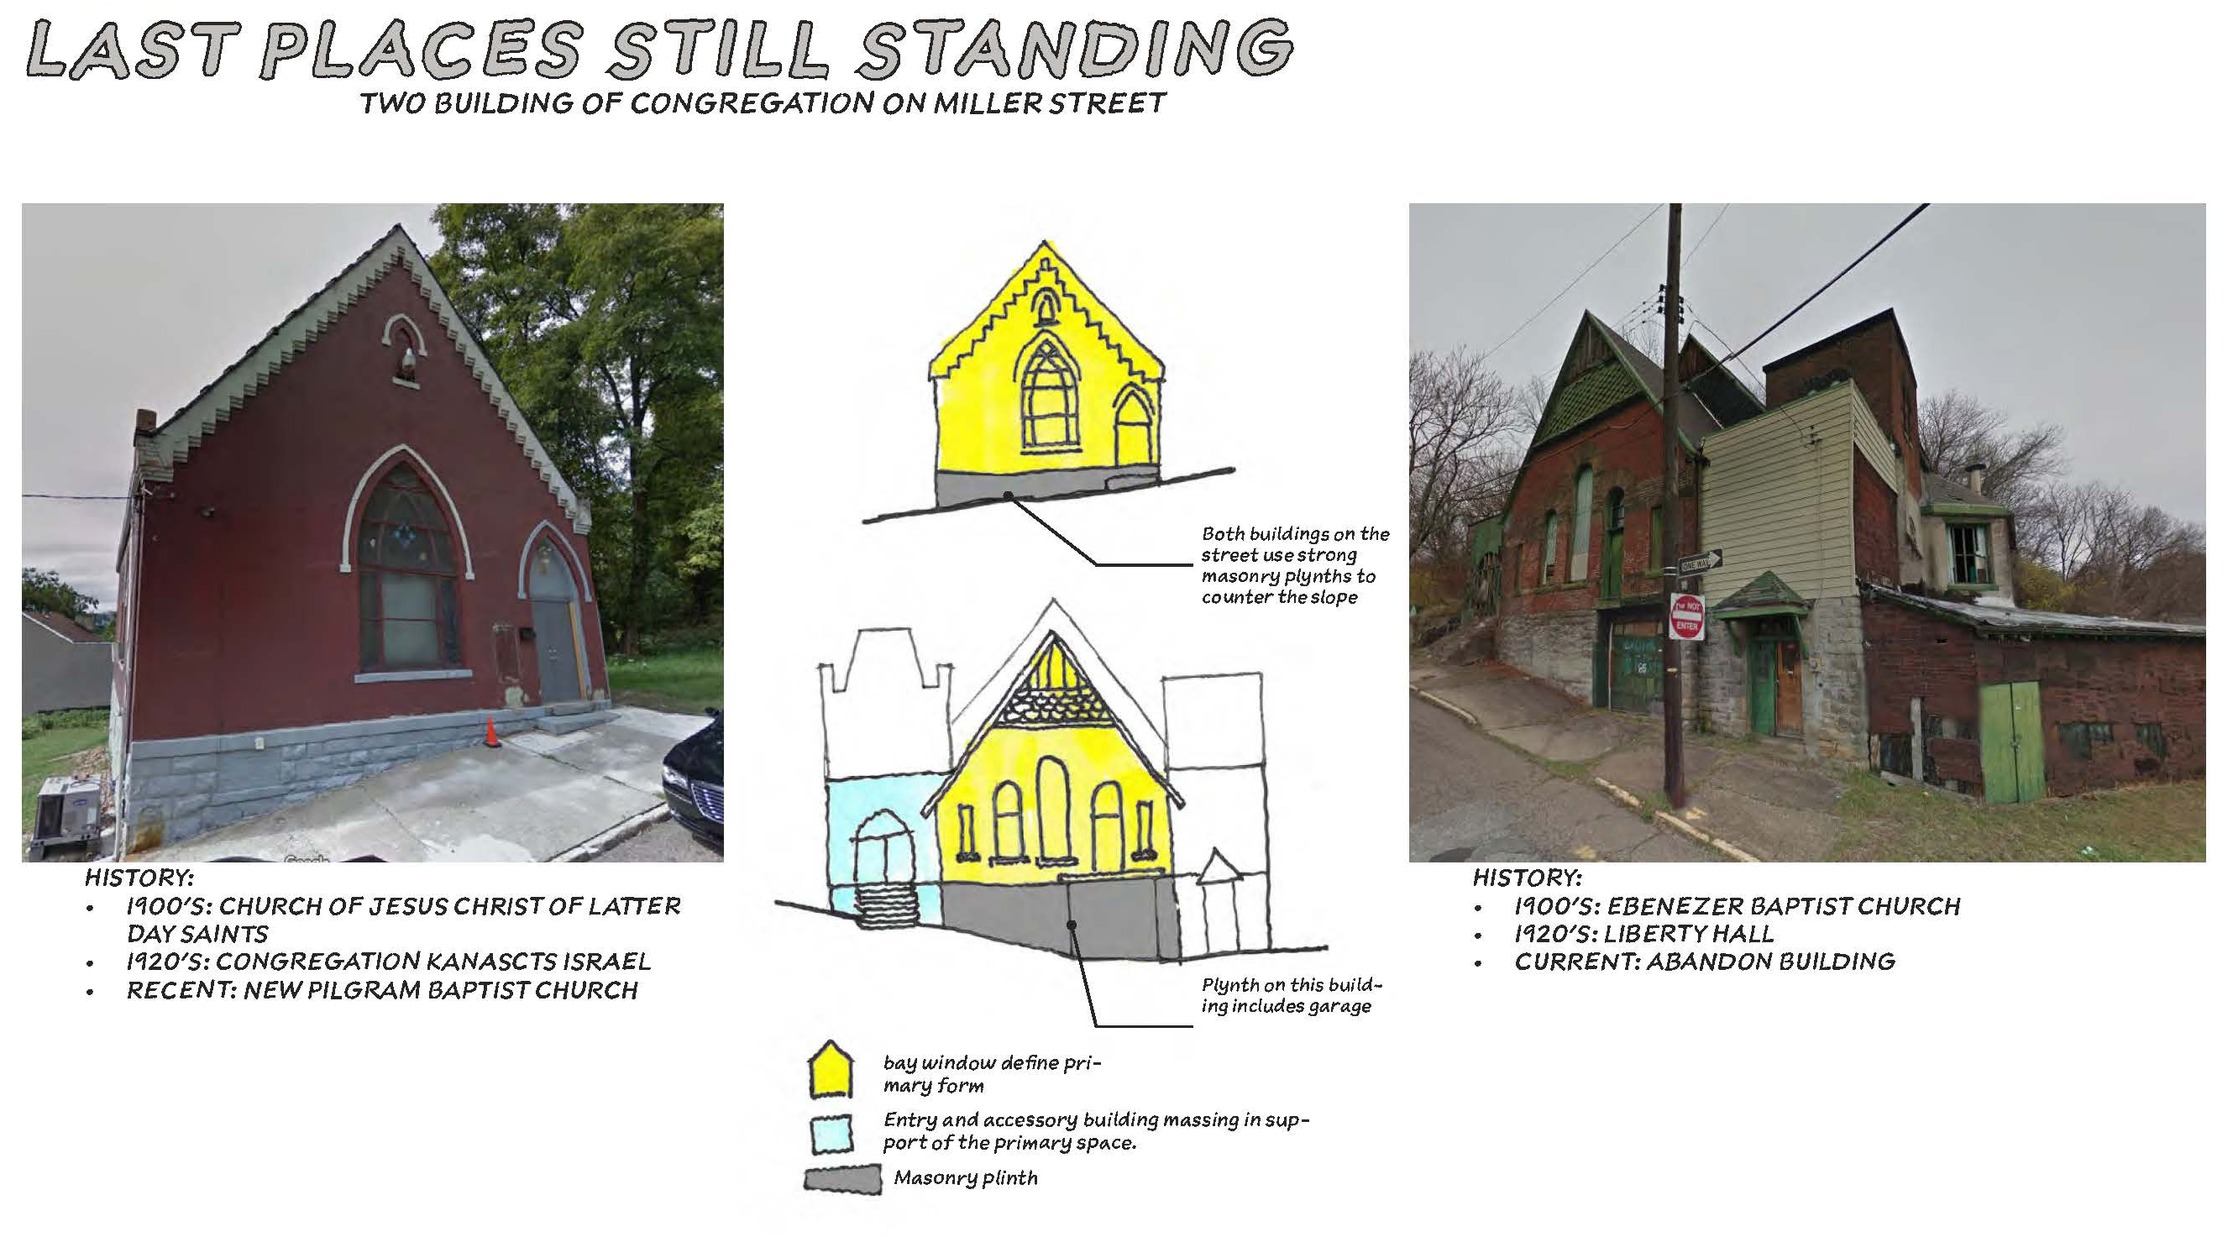
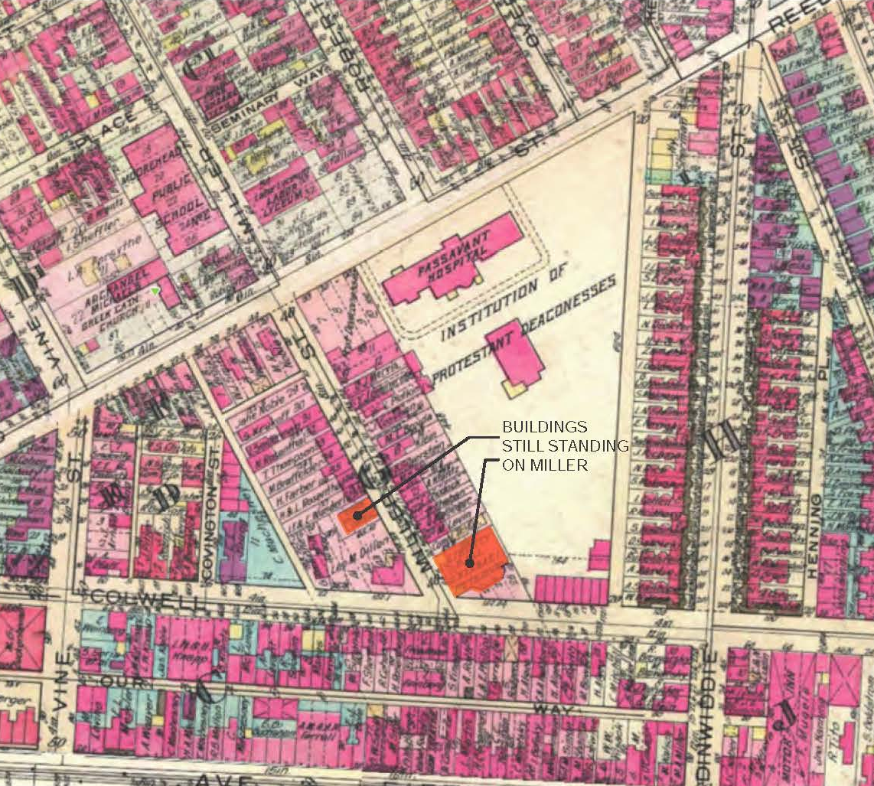
MILLER – REED FOR SALE DEVELOPMENT

Slide 11
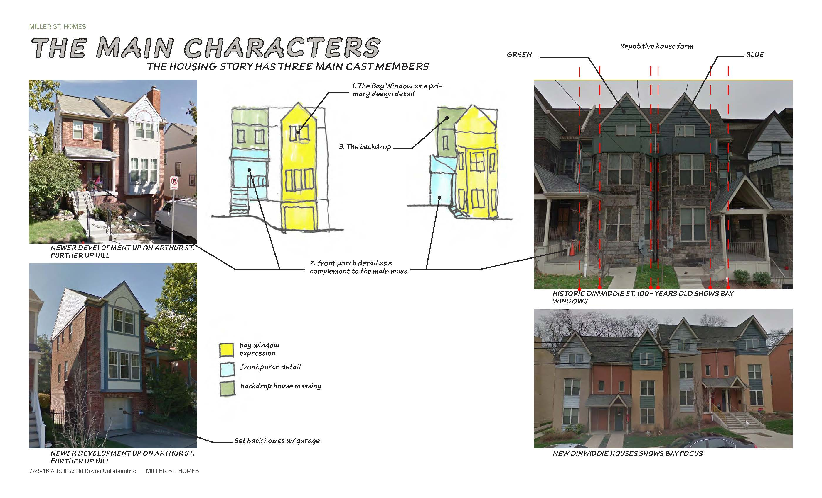
MILLER – REED FOR SALE DEVELOPMENT

Slide 12
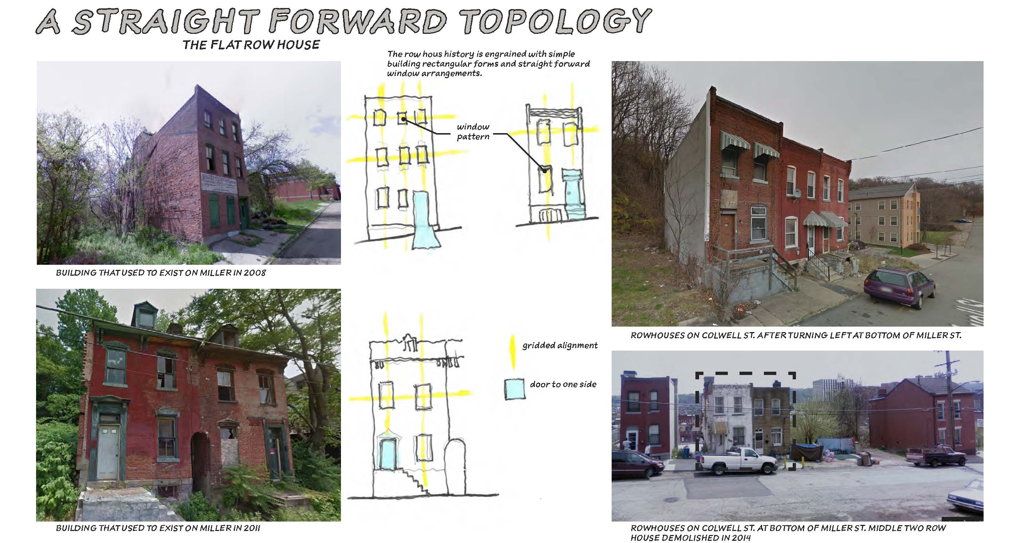
MILLER – REED FOR SALE DEVELOPMENT

Slide 13
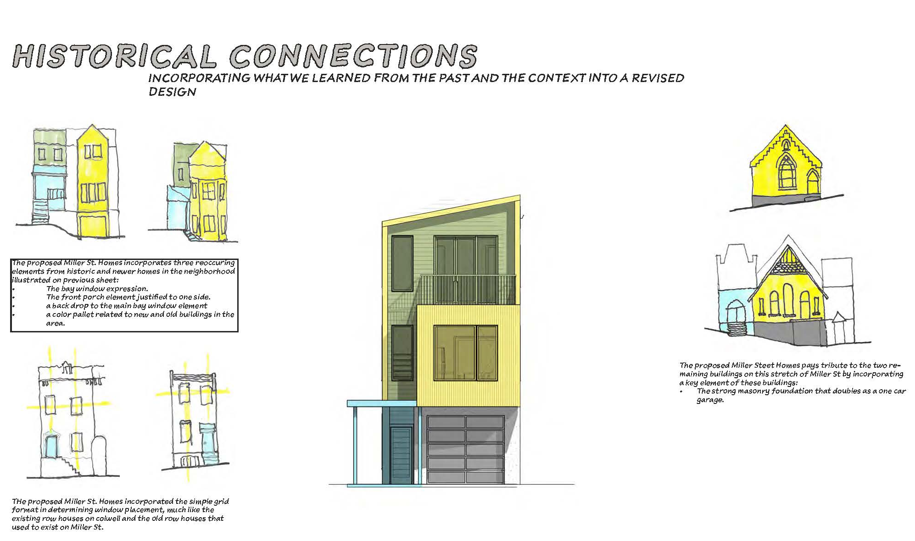
MILLER – REED FOR SALE DEVELOPMENT

Slide 14
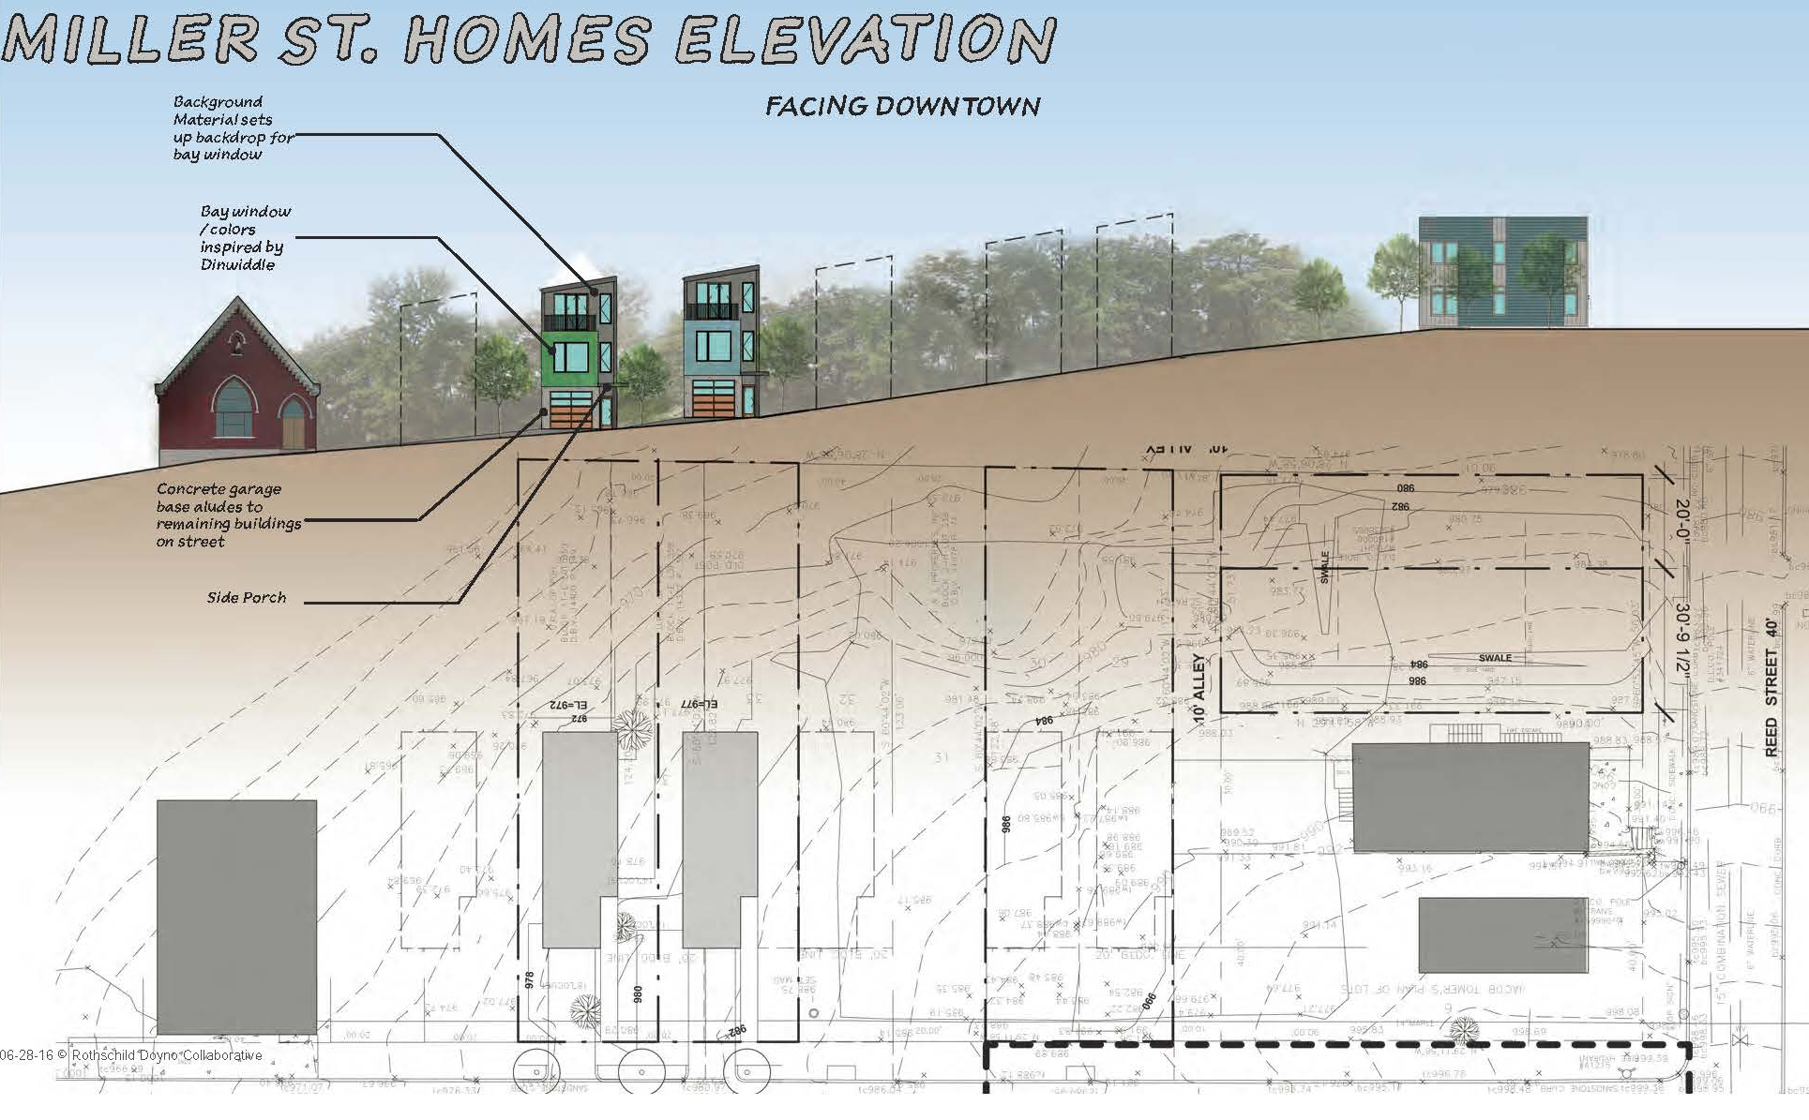
MILLER – REED FOR SALE DEVELOPMENT

Slide 15
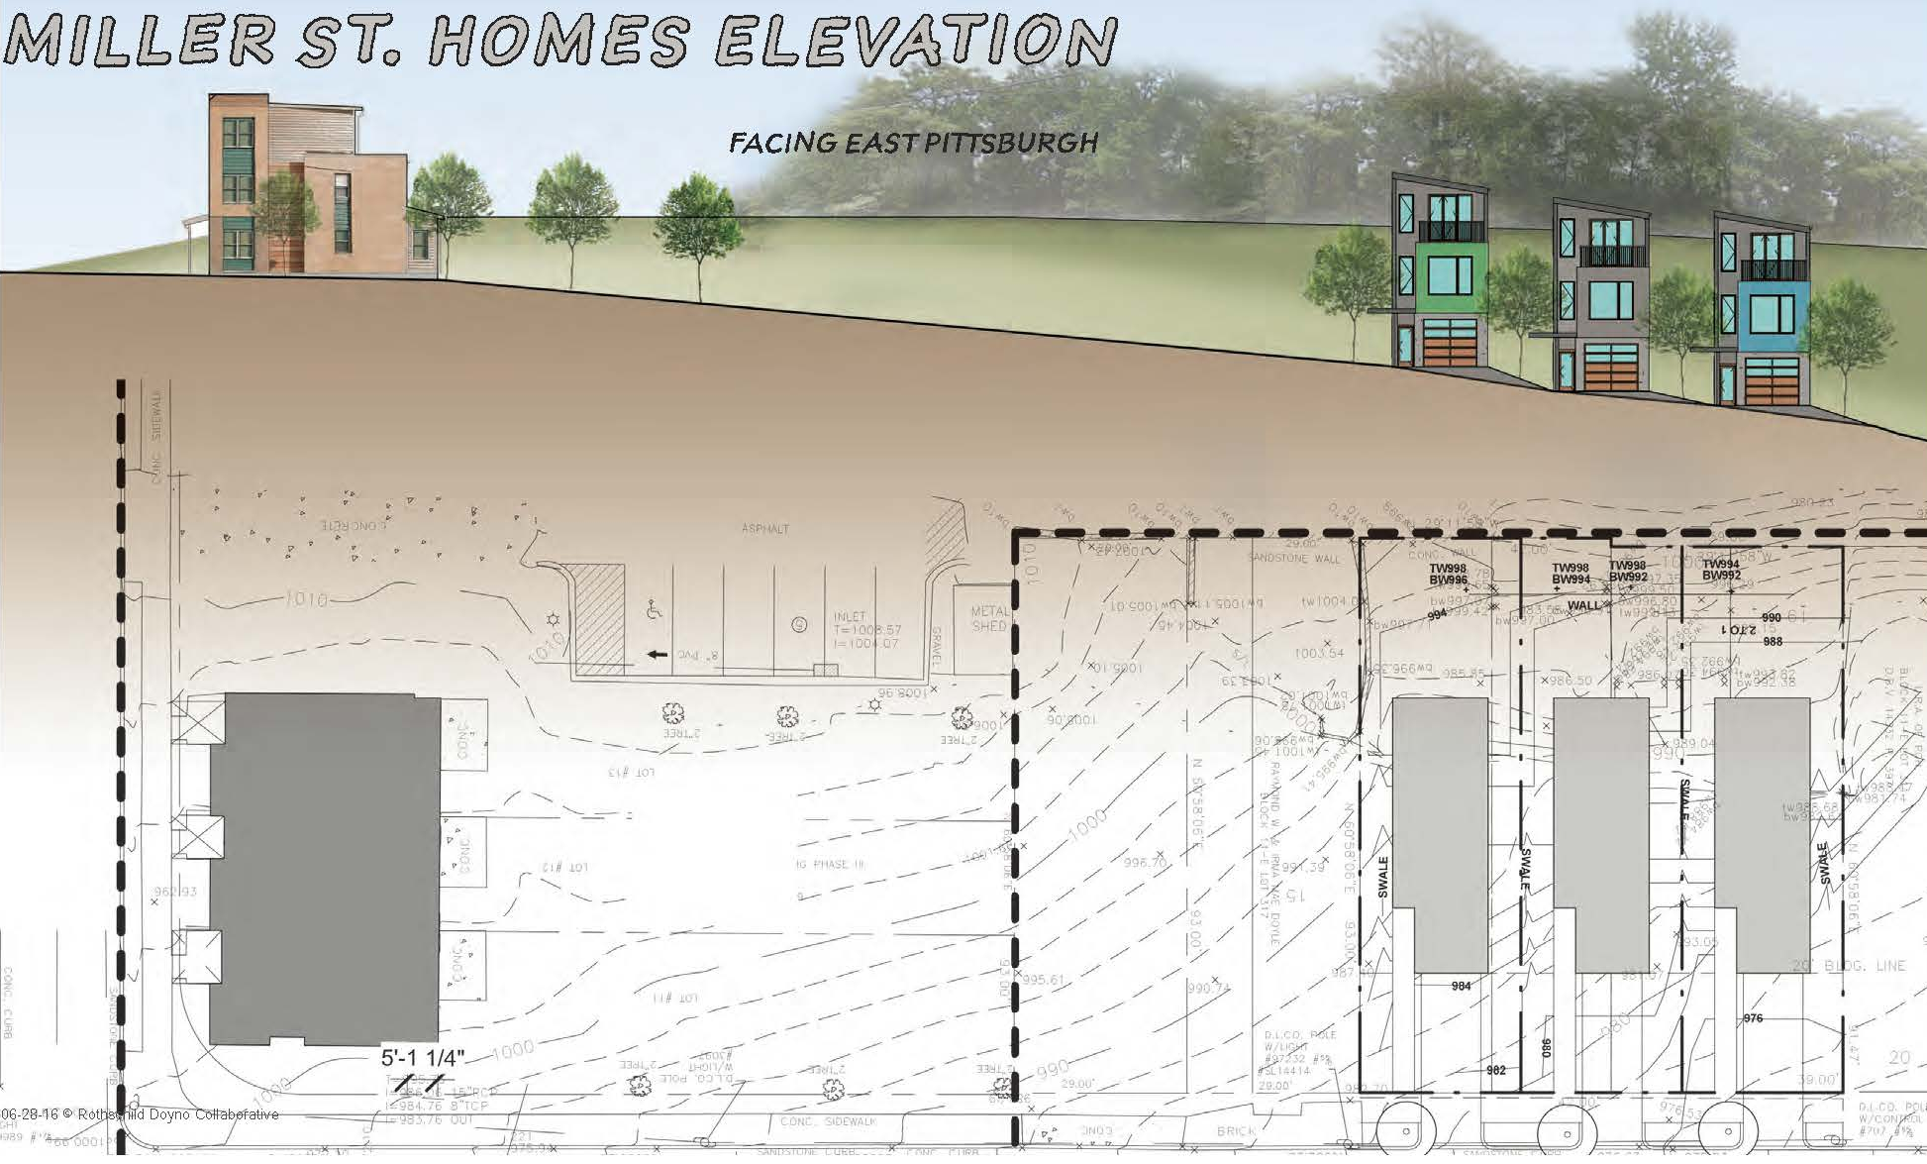
MILLER – REED FOR SALE DEVELOPMENT

Slide 16
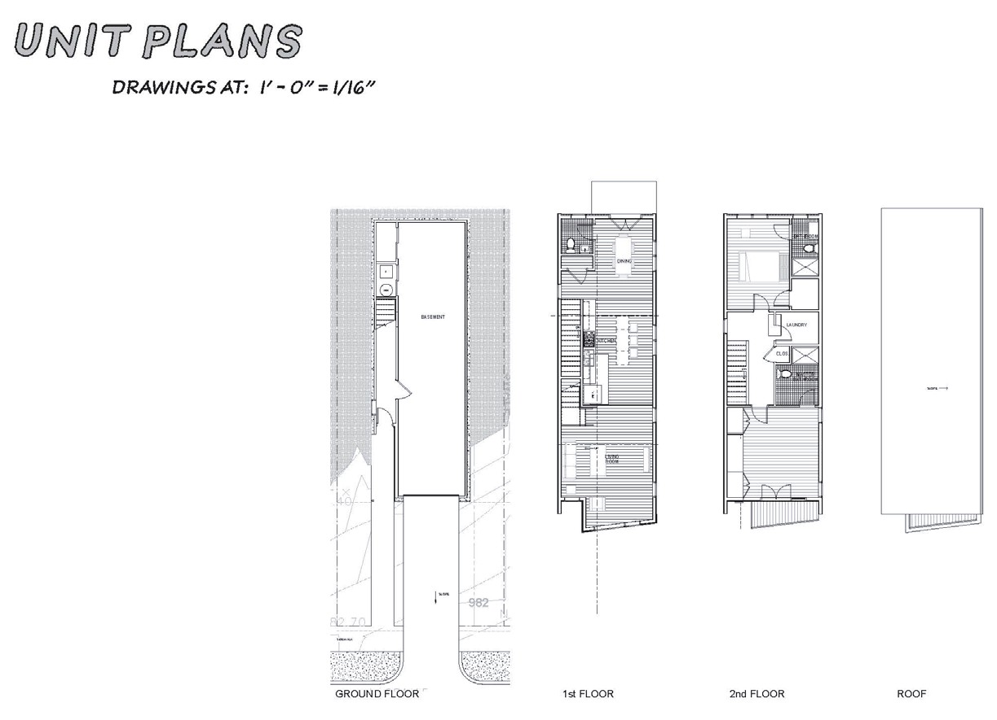
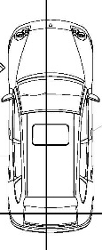
MILLER – REED FOR SALE DEVELOPMENT

