Slide 1
PROMOTER/DEVELOPER OVERVIEW
Bhoop Sehrawat
MS Env. Engg.
MS, Ph.D Applied Chemistry
bhoop@Hotmail.com
Cell: 412-995-8021
15 years residential & retail real estate development & management experience
16 years of Information Technology experience as SAP consultant
15 years of experience as Scientist, Research & Development, Polymers, Pharmaceuticals, Manufacturing, Oil & Gas Drilling

Slide 2
CHALLENGE-I
Born and brought up in a family of
Parents without any formal education – Never been to primary school
Agricultural laborer in India
Annual income of INR 2500/annum i.e. US$ 625/annum
Large family of 10 members
Two room village home of 600 sq.ft with no kitchen and no bathroom
1

Slide 3
CHALLENGE-II
Quit the executive career in India
Migrated to US in 1994 at the age of 41+
Financial Nightmare - No job, no business, no support
A fresh start from scratch – warehouse labor jobs, joined evening school for MS environmental engineering with loan, Lab technician job, transitioned to SAP consulting by 2000
Until 2008 lived in rented one-bedroom apartment without bed and slept on carpet.
Prioritized kids' education, cared ageing parents in India including home, food, healthcare & nursing

Slide 4
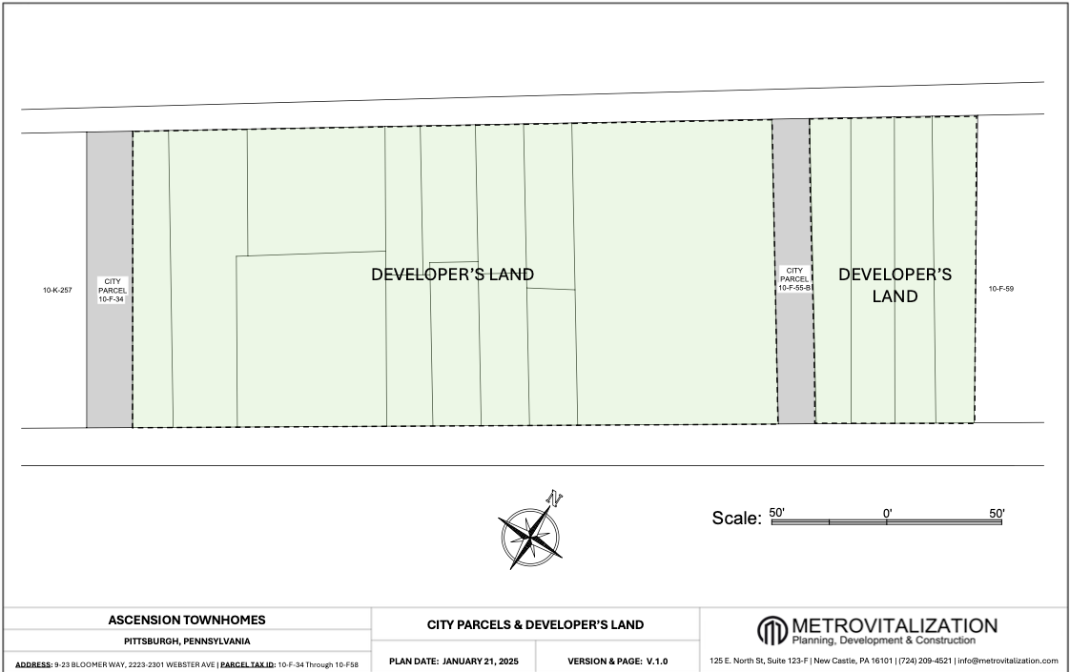
PURCHASED 17 PARCELS IN MID-HILL-2012

Slide 5
RATIONAL BEHIND PURCHASE OF 17 LOTS IN 2012
Build and develop Institution for Collaborative Efforts among Parents-Students-Teachers to groom a child as economic driver of community
Education of our children is the single most ingredient that can bring fortune to the community in a single generation.
Organizing special after-school and/or week-end custom curriculum for children to enhance their learning experience and motivate them for excellence
Coaching for a progressive and successful career
Technical skill development to provide hands-on, industry-aligned training in IT, healthcare, and trades to facilitate quick workforce entry.
But I am told that the land is available for residential use only and so is the project plan being submitted and discussed as below

Slide 6
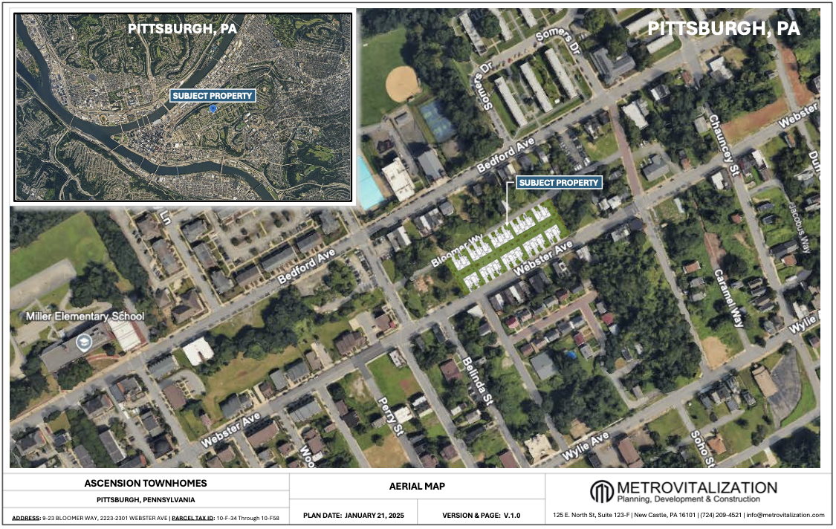
PROJECT LOCATION

Slide 7
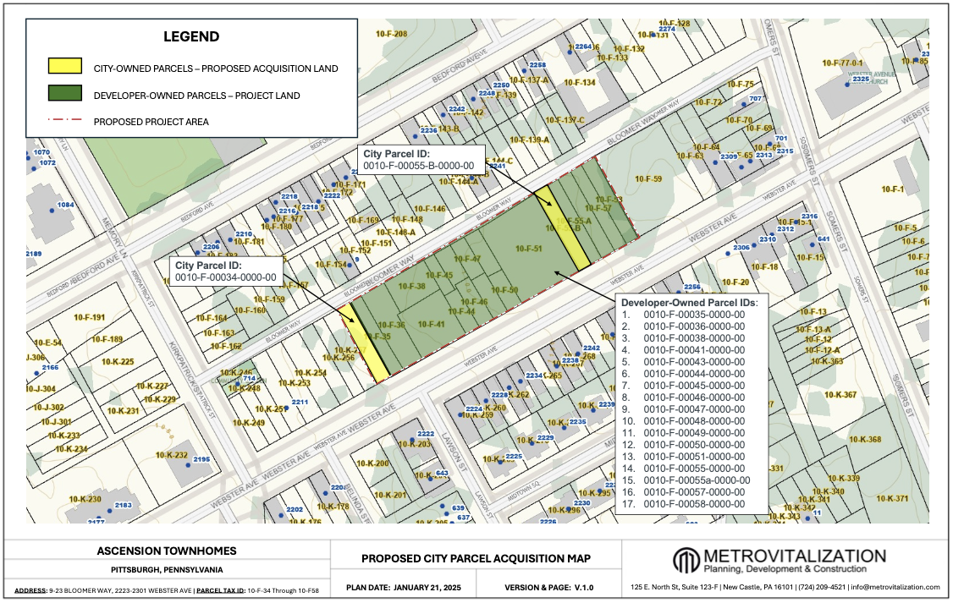
PARCELS FOR DEVELOPMENT

Slide 8
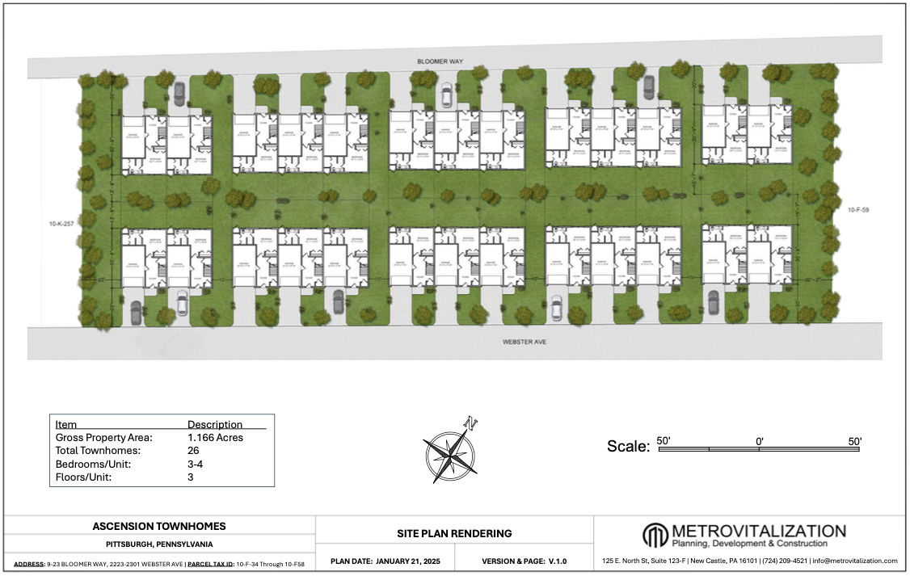
TOP VIEW LAYOUT

Slide 9
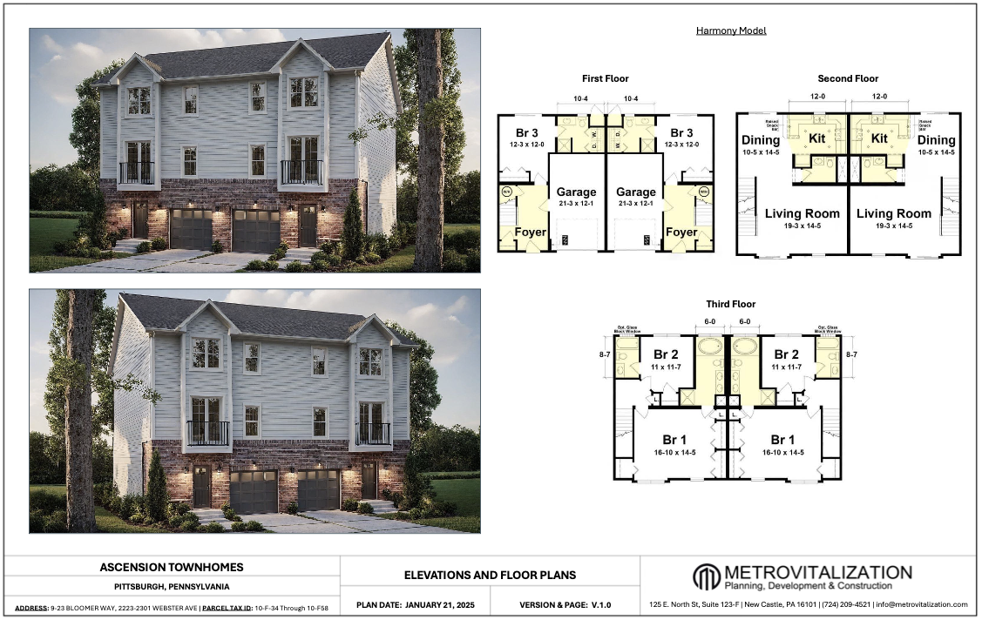
HARMONY MODEL

Slide 10
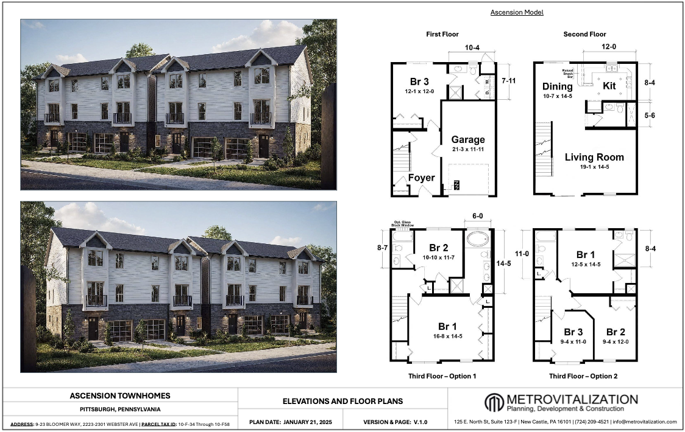
ASCENSION MODEL

