Slide 1
Proposed Acquisition aNd Improvements of Parcels 2-H-253 and 2-H-254
Prepared by Kaitlyn Turnbull

Slide 2
Project Executive Summary
Kaitlyn Turnbull seeks to acquire two vacant side lots adjacent to 8 Reed Street in Pittsburgh's Hill District to transform currently neglected, underutilized parcels into a safe, attractive, and sustainable community asset. The proposed project will replace overgrown vegetation and accumulated debris with landscaped green space, raised garden beds, and a modest off-street parking area to improve neighborhood aesthetics, enhance safety, and provide functional infrastructure for residents.
As long-term property owners and community stakeholders, our team is committed to maintaining these improvements and serving as responsible stewards of the site.
This investment supports the Urban Redevelopment Authority's mission by reducing blight, promoting environmental sustainability, and contributing to the continued revitalization of the Hill District through thoughtful, community-centered redevelopment.

Slide 3
Proposal Goals
The primary goals of this project are to:
Beautify and stabilize currently vacant lots by transforming them into maintained, productive, and visually appealing spaces.
Promote sustainability and community engagement through the installation of raised garden planters for growing flowers, herbs, and vegetables.
Improve neighborhood functionality and safety by adding surface parking area to alleviate on-street congestion and provide secure parking for residents and visitors.

Slide 4
Project TeaM
Kaitlyn Turnbull, RN – Homeowner
Kaitlyn Turnbull is a Registered Nurse and the founder of Refuge Properties LLC. She currently provides care for women through the nonprofit Network of Life, supporting mothers throughout pregnancy and the postpartum period. Her experience in healthcare has given her a deep appreciation for the importance of safe, healthy, and supportive communities.
Rev. Kenneth Turnbull – Project Manager
Ken Turnbull earned his bachelor's degree from the Pennsylvania State University before completing his theological education with the Christian and Missionary Alliance. He served Allegheny Center Alliance Church for more than 40 years in leadership roles, including Operations Pastor and Community Pastor.
Brenden Bogolin, M.Arch., LEED AP BD+C – Rendering Architect
Brenden Bogolin earned his bachelor's degree from Arizona State University and his Master of Architecture from Carnegie Mellon University. He is an architect with SmithGroup in downtown Pittsburgh and is a LEED Accredited Professional in Building Design and Construction (LEED AP BD+C).

Slide 5
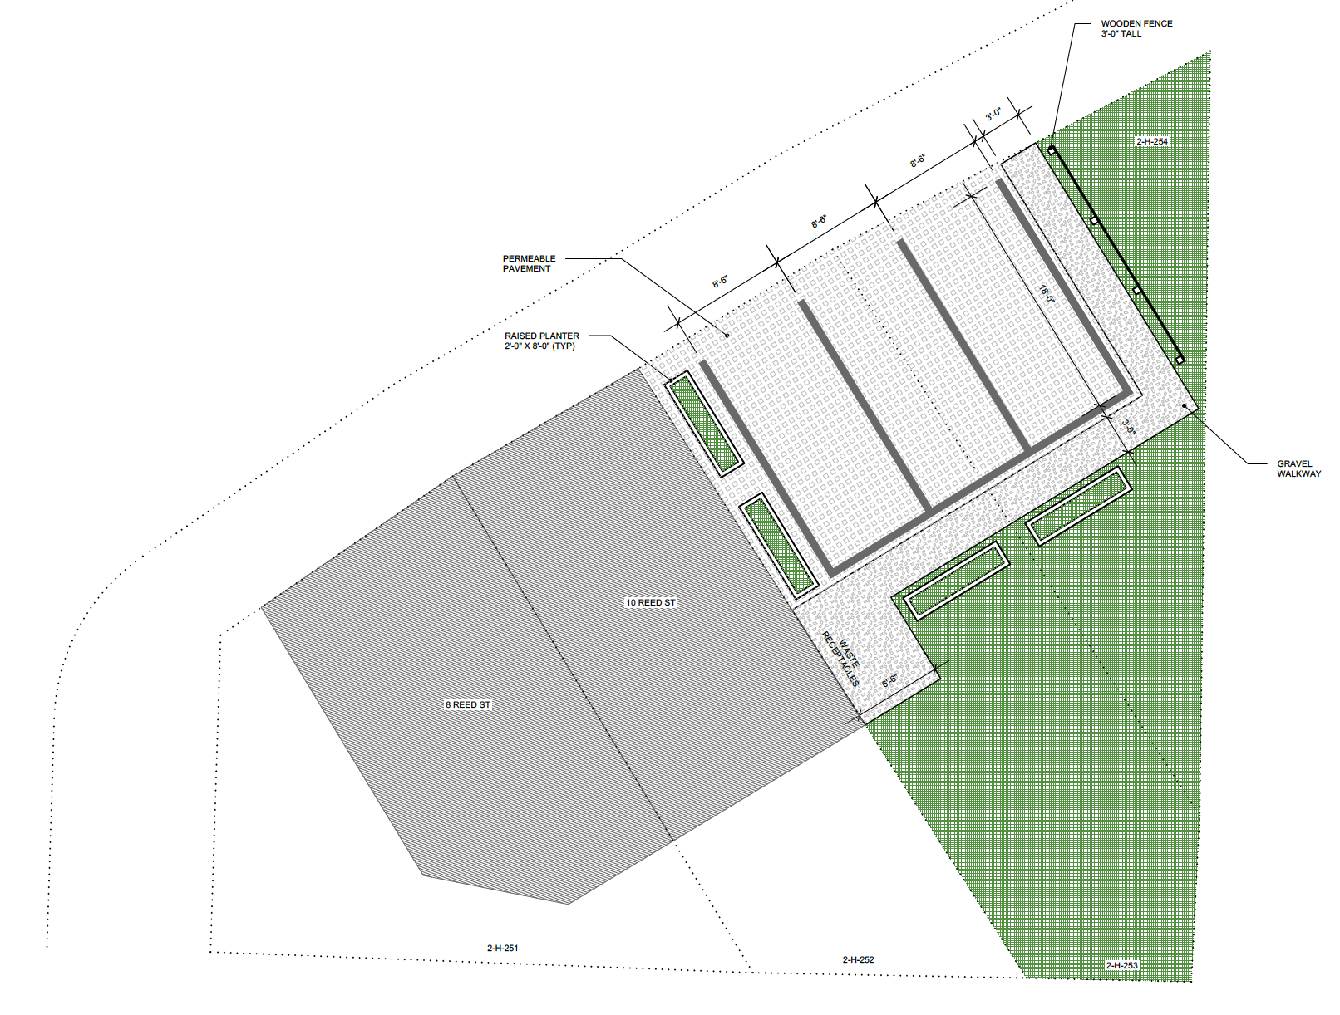
Project Illustration

Slide 6
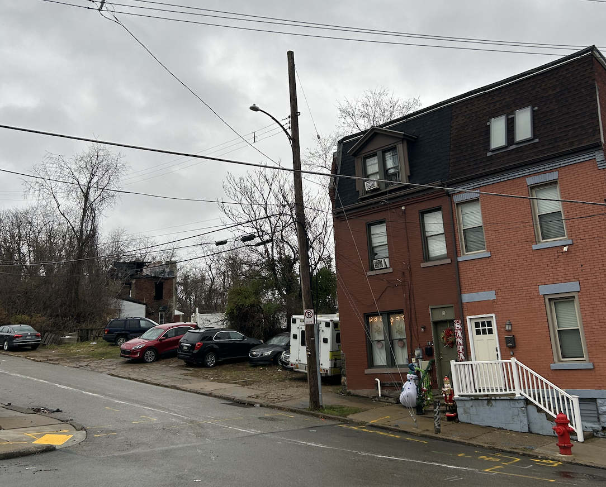
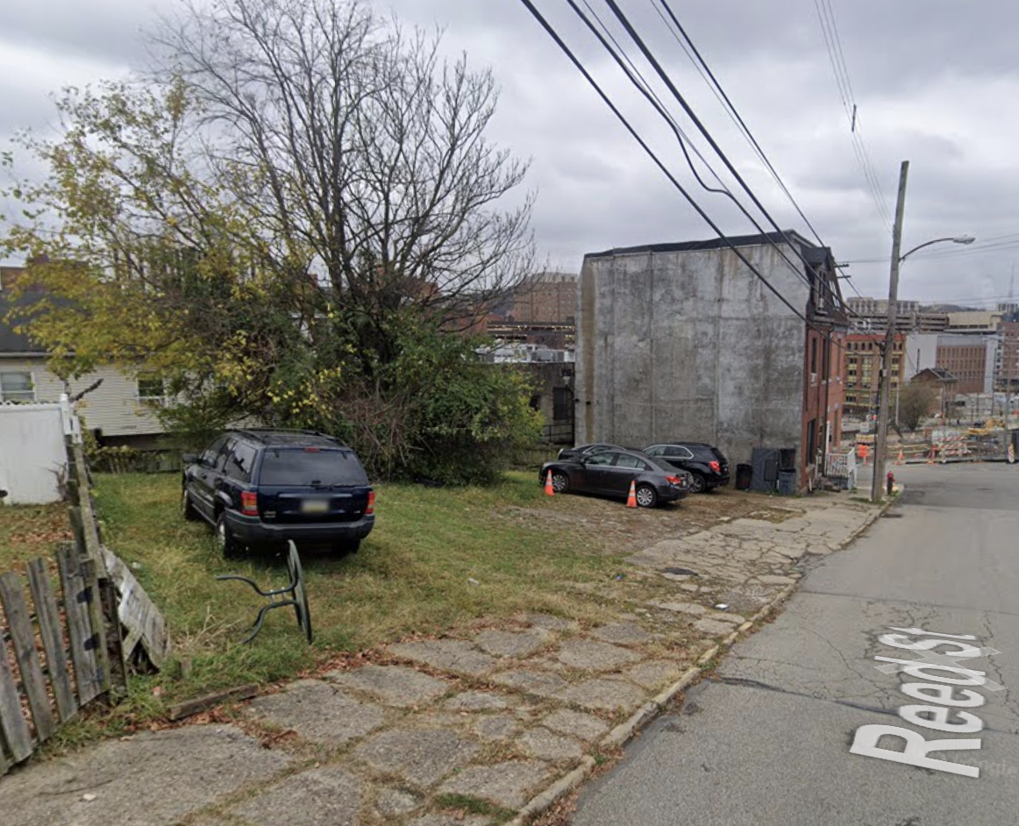
Site Photos

Slide 7
Budget
Category | Description | Estimated Cost
Site Preparation | Grading, debris clearing, minor leveling | $500
Landscaping & Garden Installation | Topsoil, compost, mulch, and planting materials | $500
Raised Planters | Lumber or composite materials, hardware, soil fill, installation labor (4-6 planters) | $400
Surface Parking Installation | Excavation, gravel base, permeable pavers or crushed stone, edging, compaction | $1000
Fencing | Split rail fencing | $200
Lighting & Safety | Safety Solar or low-voltage landscape lighting, light near parking area | $400
Permits & Fees | City of Pittsburgh permit fees, inspections and documentation (if required) | $500
Total Estimated Project Cost |  | $3,500

Slide 8
Thank You
If you require additional information about the proposed project or would like to discuss it further, please do not hesitate to reach out to me directly at 304-216-4310 or street.kaitlyn@gmail.com.
We are committed to working with the Hill District community and ensuring that this development is a positive contribution to the area.
Thank you in advance for your time and consideration. We look forward to your response and hope for your continued support in this endeavor.

